Slide 1
D.H. AND OTHERS v. THE CZECH REPUBLIC (APPLICATION NO. 57325/00)
Joint presentation by
Veronika Bazalová, Office of the Public Defender of Rights
Štěpán Drahokoupil, Open Society Fund Prague
European Implementation Network Briefing – September 6th

Slide 2
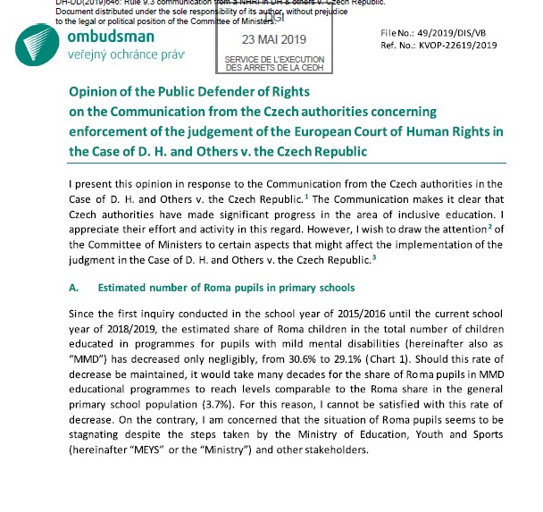
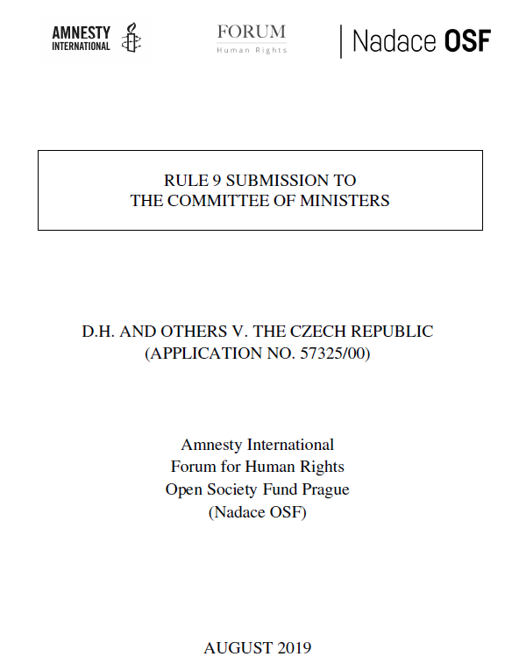
Overview
D. H. case
Data
Legislative changes
Pedagogical staff
Special schools
Segregation
Recommendations

Slide 3
D.H. and others v. the Czech Republic
2007: ECtHR decided that there exists a systemic discrimination of Roma children in the Czech Republic. The Grand Chamber agreed with 18 Roma children that were sent to special schools and taught to a reduced educational programme:
„Despite being couched in neutral terms, the relevant statutory provisions therefore had considerably more impact in practice on Roma children than on non-Roma children and resulted in statistically disproportionate numbers of placements of the former in special schools.“

Slide 4
D.H. and others v. the Czech Republic
2012:
the Government presented first Consolidated Action Plan
Public Defender of Rights published research confirming overrepresentation of Roma among pupils with mild mental disability
2016:
new legislation, introducing support measures for pupils with special educational needs came into effect
Framework Educational Programme for Primary Education governing the education of pupils with mild mental disabilities (FEP PE MMD) was replaced with the one with adjusted outcomes due to a mental disability (FEP PE AO)

Slide 5
D.H. and others v. the Czech Republic
2018:
Committee of Ministers (1318th meeting, CM/Del/Dec(2018)1318/H46-7):
The Deputies … expressed their strong expectation that with the upcoming school years
the reform will become more and more embedded
and that, with each passing year, fewer children will be assigned to reduced education programmes, so that the share of Roma children educated outside the mainstream will continue to decrease…

Slide 6
Data, data and data

Slide 7
New diagnostic tools – the same old results
Comprehensive Evaluation of the Reform of Inclusive Education in Relation to Roma Pupils (2019):
the new diagnostic tools „guarantee the objectivity of the results of the examination of all pupils are currently being implemented in practice.”
There is no evidence for such statement.

Slide 8
Mild mental disability and reduced education programme – not the same thing

Slide 9
Proportion of Roma children – probably higher
it is highly likely that the estimated proportion of Roma pupils that are educated using the reduced education programmes, due to the diagnosis of mild mental disability being higher than the official numbers reported by the Ministry

Slide 10
Choice Between Safety and Quality Education
“Parents sometimes choose schools in socially excluded areas (often former schools for children with a mild mental disability called “primary practical schools”, authors note), because they fear bullying from a majority or because they experienced education at such a school themselves.”
Moree, Dana: Paths of Roma Pupils Towards Education - Impacts of Inclusive Education Reform, 2019
“It also appears indisputable that the Roma parents were faced with a dilemma: a choice between ordinary schools that were ill-equipped to cater for their children's social and cultural differences and in which their children risked isolation and ostracism and special schools where the majority of the pupils were Roma.”
D.H. and Others v. the Czech Republic, 2007

Slide 11
Legislative Changes
September 2016 – inclusive education reform
Decree on Education of Pupils with Special Educational Needs
December 2018 – Ministry of Education proposes changes to the Decree
Still pending
Problematic amendments:
Decrease of the maximum number of pedagogical staff per classroom
Establishment of special schools for pupils with various kinds of disabilities

Slide 12
1 Pedagogical Staff
Up to now maximum 4 teachers per classroom – up to 3 teacher‘s assistants (TAs)
Maximum 3 teachers per classroom – only 1 TA
Ministry of Education – more pedagogues in a classroom is disturbing
No data on how many pedagogues there are in the classrooms
Might lead to excessive placement of (Roma) pupils with special educational needs into special schools
Notes:
A teacher usually has 25 pupils per classroom.
In practice some schools need at least 2 TAs in the classroom:
several pupils with MMD (cannot work individually, need additional motivation) + one pupil with behavioural disorder (disrupts the instruction, needs relaxation during the class)
one boy with autism and borderline intellectual abilities + one boy with ADHD and psychiatric diagnosis + several pupils with learning disorders
one girl with MMD + one boy with ADHD and tendencies to self-harm
one pupil with autism + one pupil with different mother tongue

Slide 13
2 Special Schools
Up to now special schools established for pupils with only one type of disability
Proposal to establish special schools for pupils with various kinds of disabilities
Possible reason:
Adoption of inclusive education reform in 2016
Outflow of pupils with special educational needs into mainstream schools
Decrease of the number of pupils in special schools
Special schools have problems to fill the capacity
Special schools pressure the Ministry of Education to change the Decree
Why is it relevant to the D. H. case?
Notes:
Ministry of Education – no need for a long-distance commute
Ombudswoman – Ministry should support establishment of special classes in mainstream schools rather than establishment of all-encompassing special schools

Slide 14
2 Special Schools
All regions that reported a decrease in the proportion of children with mental disabilities also reported an increase in the proportion of children with learning and behavioural disorders
No ethnic data available
Initially the Ministry also proposed to place pupils with other kinds of disabilities in special schools for pupils with mild mental disability→ after criticism the Ministry withdrew the proposal
Still might lead to further concentration of Roma pupils in special schools
Notes:
learning disorders – dyslexia, dysgraphia
behavioural disorders – attention deficit hyperactivity disorder (ADHD)

Slide 15
Segregation in Education
According to one of the latest communication from the Czech Authorities (DH-DD(2019)673):
The Czech Republic has adopted measures intended to make sure that Roma children
are not educated under different curricula in unjustified cases and at the same time
are not educated separately from the majority population.

Slide 16
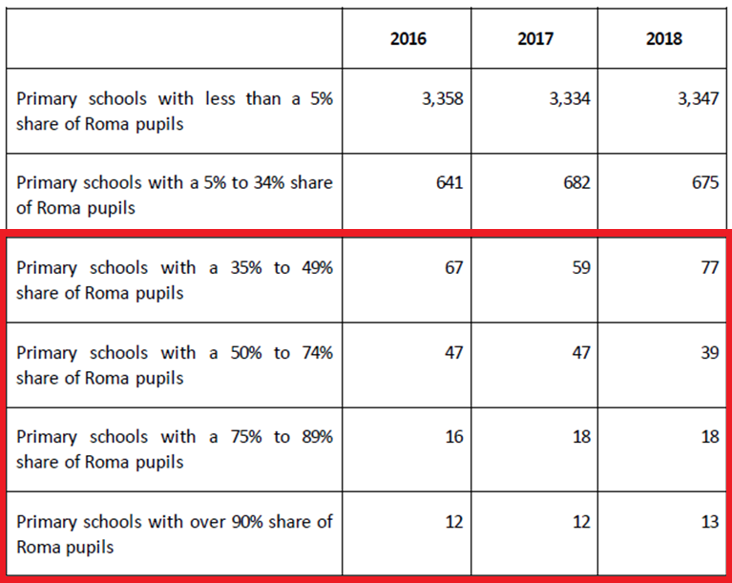

Slide 17
Recommendations for the Government
amend the Anti-Discrimination Act so that it allows for action in the public interest (actio popularis) and class action procedures to challenge institutionalized forms of discrimination,
monitor and provide disaggregated data on Roma pupils that will differentiate between pupils with mild mental disability and pupils with other disabilities educated under the reduced education programmes, so that the Committee of Ministers is presented with more accurate numbers on the implementation of the case,
withdraw from the proposal that limits number of pedagogical staff in the classroom and that allows establishment of special schools for pupils with various kinds of disabilities,
monitor the level of ethnic segregation in education and adopt appropriate desegregation measures.

Slide 18
Recommendation for the COM
monitor the implementation of the D. H. case until there is a drop in proportion of Roma educated in reduced programmes by 2,88 percent points in 5 consecutive years, starting by the school year 2018/2019
Base line situation (2017/2018): 29,5 percent
Goal: 3,6 percent after 9 years – one elementary school cycle
Goal in 2022/2023: 15,1 percent
Drop: 2,88 percent per year

Slide 19
Thank you!
Veronika Bazalová
Office of the Public Defender of Rights
veronika.bazalova@ochrance.cz
Štěpán Drahokoupil
Open Society Fund Prague
stepan.drahokoupil@osf.cz

