Slide 1
Öner and Türk Akçam Şener v. Turkey
Kerem ALTIPARMAK
Freedom of Expression Association

Slide 2
Turkish Article 10 Cases Before ECtHR
Total Fox Violations until 2018: 777
State Parties
Turkey – 321(41% of all violations)
Russia – 53
France - 38
Austria - 35

Slide 3
Holistic Approach in FoX Cases Concerning Turkey
As the Court’s jurisprudence illustrates, amelioration of certain provisions has not solved the structural problems in the Turkish law relating to freedom of expression. The judicial authorities have replaced the amended or abolished provisions with new ones to punish peaceful expression of ideas. Therefore, an amendment and results following such amendment in law might be misleading when considered in isolation.

Slide 4
The Akçam group of cases
14 judgements concerning Article 301.
The Court: Article 301 lacked the “quality of law” requirement in view of its “unacceptably broad terms” which “still resulted in a lack of foreseeability as to its effects”.

Slide 5
Akçam
Government
reiterated its previous claims relating to the amendments made in Article 301 of the Criminal Code.
stated that a new procedural right had been introduced by Law No. 7188.

Slide 6
İFÖD Findings: Akçam Case
Filtering measures presented by the government fail to guarantee the full enjoyment of freedom of speech and Article 301 still creates a climate of self-censorship.
The actual numbers are not provided by the government to assess further its claims
Ministry of Justice does not reveal the total number of investigation requests as well as how much of these requests were approved or not even subject to freedom of information requests subject to Law No. 4982

Slide 7
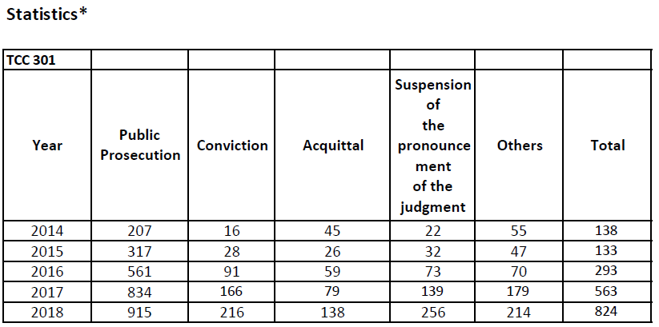
Statistics on Article 301

Slide 8
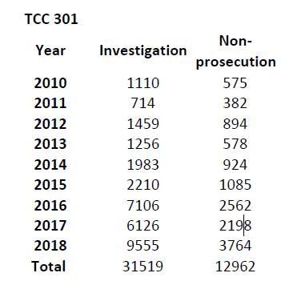
Statistics on Article 301-2

Slide 9
The Şener Group
The Şener group compromises of 38 judgements concerning violations of the applicants’ right to liberty and security and right to freedom of expression on account of detention on remand of the applicant investigative journalists, charged under Articles 314 and 220/7 of the Turkish Criminal Code with aiding and abetting a criminal organization by having been involved in the production of publications criticizing the government and/or serving as propaganda for a criminal organization.

Slide 10
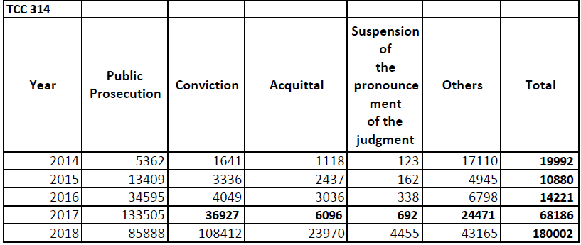
Şener Group –Developments
there have been no fundamental legislative developments concerning Articles 220 and 314 of the Criminal Code.

Slide 11
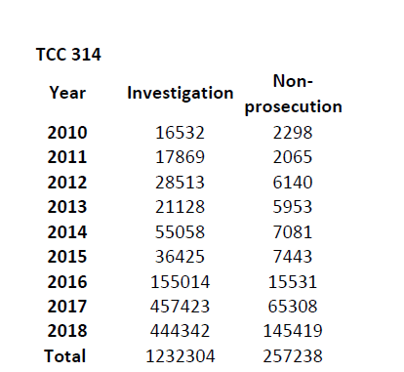
Membership Statistics

Slide 12
Şener Group – İFÖD Findings
At least 100 journalists have been on trial either for being a member of PKK or for making its propaganda
Out of 100 individuals, 92 of them have been detained at pre-trial stage.
At least 79 of those individuals have been charged merely due to the institution they worked for.
The 38 Editors-in-Chief on Watch for Özgür Gündem have been facing charges.

Slide 13
Öner and Türk Cases
The Öner and Türk group of cases (no. 51962/12) comprise of 32 cases2 involving unjustified interferences with freedom of expression, in particular through criminal proceedings, and the consequent chilling effect.
This particular group mainly concern Articles 215 and 216 of the Turkish Criminal Code and Articles 6/2 and 7/2 of Anti-Terrorism Act.

Slide 14
Öner and Türk- İFÖD Findings
While only 669 persons were convicted under Article 7/2 of Anti-Terror Law in 2014, 6.162 persons were convicted in 2017. If explained in percentages,
Increase in convictions are close to 1000%, which is not included in the Government’s Action Plan.

Slide 15
Öner and Türk – İFÖD Findings
While prosecutions brought under Article 215 of the Criminal Code decreased, a substantial increase has taken place in prosecutions based on terror propaganda and membership charges since 15 July, 2016.
Therefore, various terrorism provisions are continuously used to create a hostile environment for journalists.

Slide 16
Constitutional Court – An Effective Remedy?
The Constitutional Court has delivered decisions in 34 applications brought by journalists who were deprived of liberty due to terror charges.
It found violations only in 9 cases. It found 12 applications inadmissible and found no violations in 13 others.

Slide 17
Conclusions
There has been no progress achieved with regard to the provision of an adequate legislative framework that enables the protection of Article 10 and full and effective implementation of Öner and Türk; Şener and Akçam group of cases.
Previous amendments introduced have not produced the results suggested by the Government
Recent amendments made in the Turkish Criminal Code and Anti-Terror Law do not meet the Committee of Ministers’ requirement of fully aligning with the Court’s case law

Slide 18
Recommendations
The Government should be asked to provide detailed data about the implementation of relevant provisions of the Criminal Code and Anti-Terror Law.
The government should also be asked to provide examples where persons have been convicted under the relevant provisions.
A comparative list of Constitutional Court judgments should also be provided.
The Öner and Türk; Şener and Akçam group of cases should remain under enhanced procedure

