Slide 1
Joint briefing to the Committee of Ministers 1 March 2024 Öner and Türk Group (Appl. No. 51962/12) Nedim Şener Group (Appl. No. 38270/11) Altuğ Taner Akçam Group (Appl. No. 27520/07) Artun and Güvener Group (Appl. No. 75510/01) Işıkırık Group (Appl. No. 41226/09)

Slide 2
Group of cases
Application no. | Group of cases | Judgment Date (leading case) | Finalization date (leading case) | Source of violation / the violation
51962/12 | Öner and Türk Group | 31/03/2015 | 30/06/2015 | ATL Articles 6-2, 7-2 & TCC Articles 215, 216 / (Article 10 of the ECHR)
41226/09 | Işıkırık Group | 14/11/2017 | 09/04/2018 | TCC Article 220/6- 7 / (Articles 10 and 11 of the ECHR)
27520/07 | Altuğ Taner Akçam Group | 25/10/2011 | 25/01/2012 | TCC Article 301 / (Article 10 of the ECHR)
75510/01 | Artun and Güvener Group | 26/06/2007 | 26/09/2007 | TCC Articles 125 and 299 / (Article 10 of the ECHR)
38270/11 | Nedim Şener Group | 08/07/2014 | 08/10/2014 | CCP Article 100 / (Articles 5 and 10 of the ECHR)
TCC = Turkish Criminal Code
ATL= Anti-Terrorism Law
CCP= Code on Criminal Procedure

Slide 3
Joint Rule 9.2 Submissionsubmission on behalf of 17 NGOs
Truth Justice Memory Center (Hakikat Adalet Hafıza Merkezi)
Civil Rights Defenders
Initiative for Freedom of Expression (Düşünce Suçuna Karşı Girişim - IFOX)
Association for Monitoring Equal Rights (Eşit Haklar İçin İzleme Derneği - ESHID)
The Rights Initiative (Hak İnisiyatifi Derneği)
Human Rights Association Istanbul Branch (İnsan Hakları Derneği İstanbul Şubesi)
Women’s Time Association (Kadın Zamanı Derneği)
Lambdaistanbul LGBTI+ Solidarity Association (Lambdaistanbul LGBTİ+ Dayanışma Derneği)
Media and Law Studies Association (Medya ve Hukuk Çalışmaları Derneği - MLSA)
P24 Independent Journalism Association (P24 Bağımsız Gazetecilik Derneği)
Research Institute on Turkey (RIT)
Roma Memory Studies Association (Roman Hafıza Çalışmaları Derneği - Romani Godi)
Social Policy, Gender Identity and Sexual Orientation Studies Association (Sosyal Politika, Cinsiyet Kimliği ve Cinsel Yönelim Çalışmaları Derneği - SPoD LGBTİ+)
Foundation for Society and Legal Studies (Toplum ve Hukuk Araştırmaları Vakfı - TOHAV)
Turkey Human Rights Litigation Support Project (Türkiye İnsan Hakları Davalarına Destek Projesi)
University Queer Research and LGBTI+ Solidarity Association (Üniversiteli Kuir Araştırmaları ve LGBTİ+ Dayanışma Derneği - ÜniKuir)
Life Memory and Freedom Association (Yaşam Bellek Özgürlük Derneği)

Slide 4
Öner and Türk group of cases
Article 6 § 2 of ATL- printing of statements made by a terrorist organization
Amendment added in 2013: “condoning, praising or encouraging methods [using] coercion, violence or threats”
Article 7 § 2 of ATL - propaganda in favour of an illegal organisation
Amendment added in 2013: “by justifying, praising or encouraging the use of methods constituting coercion, violence or threats”
Amendment added in 2019: “Expressions of thought that do not exceed the limits of reporting or for the purpose of criticism shall not constitute a crime”
No new amendment, continuing violations

Slide 5
Öner and Türk group of cases
Article 215 of CC - praising an offence or an offender
Amendment added in 2013: “…provided that there emerges an imminent and clear danger to the public order”
No new information provided
Article 216 of CC - provoking the public to hatred, hostility, denigrating a section of the public on grounds of social class, race, religion, sect, gender or regional differences
No amendment
No information provided in the action plan

Slide 6
Öner and Türk group of cases
Article 6 § 1 of ATL - disclosing or publishing the identities of officials on counter-terrorism duties, or identifying such persons as targets
Ambiguous wording, increasing use against journalists and rights defenders
Previously examined before the ECtHR and the CM

Slide 7
Işıkırık group of cases
Article 220 § 6 of the CC - committing an offense on behalf of an organization without being a member
Hamit Yakut pilot judgment of the Constitutional Court (2021) – not implemented by the Parliament
Annulment by the Constitutional Court (2023) – comes into force on 8 April 2024
Legislative proposal (currently before Parliament) offers no change
Article 220 § 7 of the CC - aiding and abetting an organization willingly and knowingly without belonging to its structure
Amendment added in 2013: “by justifying, praising or encouraging the use of methods constituting coercion, violence or threats”
The Constitutional Court found it meets the legality requirement
No new amendment foreseen

Slide 8
Işıkırık group of cases
Government is reinstating the exact same provision as the Article 220/6
Old version | Newly Proposed version
(6) A person who commits a crime on behalf of an organization without being a member of the organization shall also be punished for the crime of being a member of the organization. The penalty to be imposed for the crime of being a member of an organization may be reduced by up to half. The provision of this paragraph shall only apply to armed organizations. | (6) A person who commits a crime on behalf of an organization without being a member of the organization shall also be sentenced to imprisonment from two years and six months to six years. Depending on the nature of the offense committed, the sentence may be reduced by up to half. The provision of this paragraph shall only apply to armed organizations."

Slide 9
Altuğ Taner Akçam group of cases
Article 301 of the CC - publicly denigrating the Turkish nation or the organs and institutions of the state, including the judiciary and the army
Amended in 2008: denigrating “Turkish nation” instead of “Turkishness”, lower sentences + authorization from Ministry of Justice required for investigation
The ECtHR found the provision does not meet the “quality of law” requirement since “its unacceptably broad terms result in a lack of foreseeability as to its effects” (Altuğ Taner Akçam v. Turkey, § 95)
Despite calls from the CM, no new amendment since the Taner Akçam judgment

Slide 10
Artun and Güvener group of cases
Article 125 of the CC – insulting
No new amendment
Article 299 of the CC – insulting the President
No new amendment
Action plan argues that “no abolishment is required” and Ministry of Justice authorization required for prosecution functions as a filtering mechanism
latest CM decision calling for the abrogation of Article 299

Slide 11
Nedim Şener group of cases
Group focuses on pre-trial detention of individuals, mainly journalists, without relevant and sufficient reasons, on serious charges (offenses against the constitutional order, establishing organizations for the purpose of committing crimes)
Article 100 of the Code on Criminal Procedure
Pre-trial detention used as a punitive measure and no concrete evidence sought
Lower courts even find Article 100 insufficient
CM called for the judiciary to “rely on concrete evidence justifying strong suspicion when placing individuals in detention”

Slide 12
Main concerns
“Expressions of thought that do not exceed the limits of reporting or for the purpose of criticism shall not constitute a crime” - similar phrases added over the years had no positive impact
Broad wording of provisions and arbitrary conduct of the judiciary
Troubling approach associating any dissenting opinion with terrorism
Circumventing provisions
Non-implementation of Constitutional Court judgments
Individual applications
Annulment decisions – Parliament reluctant to make required legislative changes in a Convention-compliant manner

Slide 13
Freedom of expression cases trial monitoring program
400+ hearings 233 cases | 20+ different cities in Turkey 1600+ defendants

Slide 14
KEY FINDINGS
Öner and Türk v. Türkiye: Terrorism charges still the primary charge against freedom of expression in Turkey.
Işıkırık v. Türkiye: Annulled Article 220/6 of TPC is being reinstated and circumvented by Article 220/7.
Nedim Şener v. Türkiye: Detention is used as a punishment mechanism in freedom of expression cases.

Slide 15
ÖNER AND TÜRK GROUP
Terror charges are the most frequent charge in freedom of expression cases by making up for almost half of all the charges - 103 cases.
Terrorist propaganda (Anti Terror Law – 7§2) is the second crime most often prosecuted in the report – 46 cases (%15).
The government introduced amendments in 2019 to the article but courts are still failing to differentiate between terrorist propaganda and news content.

Slide 16
ÖNER AND TÜRK GROUP
Terrorist organisation membership (7§1)
Main charge in 10% of all cases
Targeting those involved in counter-terrorism efforts (6§1)
First detention of a journalist under this article: Fırat Can Arslan
12 cases filed under this provision

Slide 17
ÖNER AND TÜRK GROUP
Circumventing implementation
Targeting the individuals involved in counterterrorism
(Anti Terrorism Law – 6§1)
is being used to circumvent the other provisions reviewed by the committee.
It was charged 12 times in last period.

Slide 18
CASE OF FIRAT CAN ARSLAN
First journalist ever detained under this charge.
Against the Criminal Procedure Code, the judge and the prosecutor in Diyarbakır 18 Journalists Trial were married and appointed to another city.
When Fırat Can Arslan shared the news by posting the Official Gazette’s appointment section on twitter, he was charged with targeting and detained for 100 days.
Subsequently acquitted in the first hearing.

Slide 19
ÖNER AND TÜRK GROUP
Circumventing implementation
Terrorist organization membership
(Anti Terrorism Law – 7§1)
is being used to circumvent the other provisions reviewed by the committee.
Evidence used in connection to these charges are mostly composed of news articles and social media posts.
It was used in almost 10 % of all freedom of expression cases.
In total, in 3 cases, 5 defendants were sentenced to 31 years, 3 months and 9 days in total.

Slide 20
Evidence of terrorist membership
News articles/articles/publications/photographs | 20
Social media posts | 11
Membership of association/political party/ organization, institution where he/she works | 9
Crime scene/detention reports | 9
Attended meeting/demonstration/march/press release | 8
Technical-physical surveillance reports | 8
Statements | 6
Secret witness statement | 5
Telephone interviews with news sources | 5
Witness statements | 5
Mobese/camera footage | 4
Denunciation/criminal complaint against the defendant | 3
Financial transactions | 1

Slide 21
Işıkırık v. Türkiye Group
Article 220/6 of TPC: committing a crime on behalf of a criminal organization without being a member
In one case, four journalists were sentenced to 11 years due to this charge
Article 220/7 of TPC: willingly aiding a criminal organization
In two freedom of expression cases, 32 defendants were sentenced to almost 103 years imprisonment on this charge.

Slide 22
Nedim Şener v. Türkiye Group
Number of detained journalists is misleading without context
Compared to last year the detained defendants increased by 150%
Dicle Müftüoğlu was imprisoned without her lawyer being allowed to make a defense statement in the first hearing.

Slide 23
Case of Dicle Müftüoğlu
Imprisoned since April 2023
Her case is only composed of her journalistic activities.
No evidence was produced during her detention.
The Court ordered the continuation of her detention without obtaining her lawyers’ defense.
She was released yesterday.

Slide 24
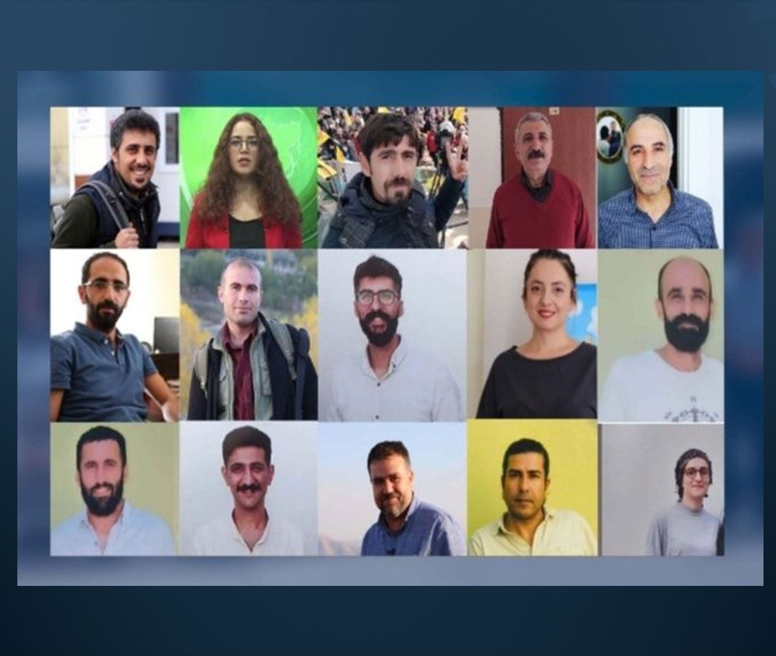
Case of Diyarbakır 18 Journalists
Detained in June 2022
No indictment was filed for 9 months
First hearing after 13 months
Released after the first hearing
13 months detention

Slide 25
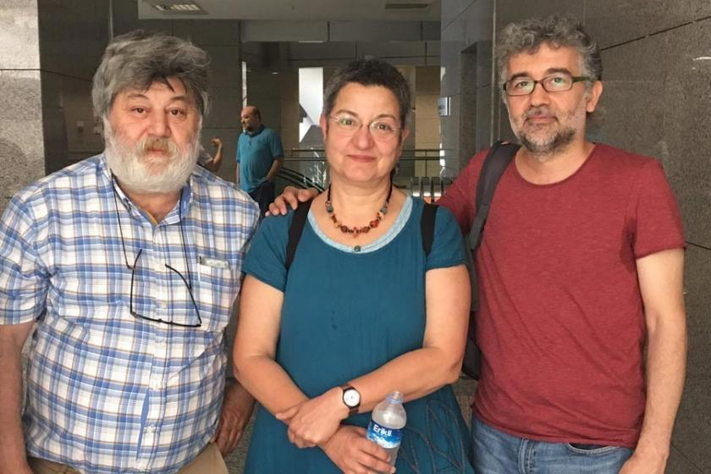
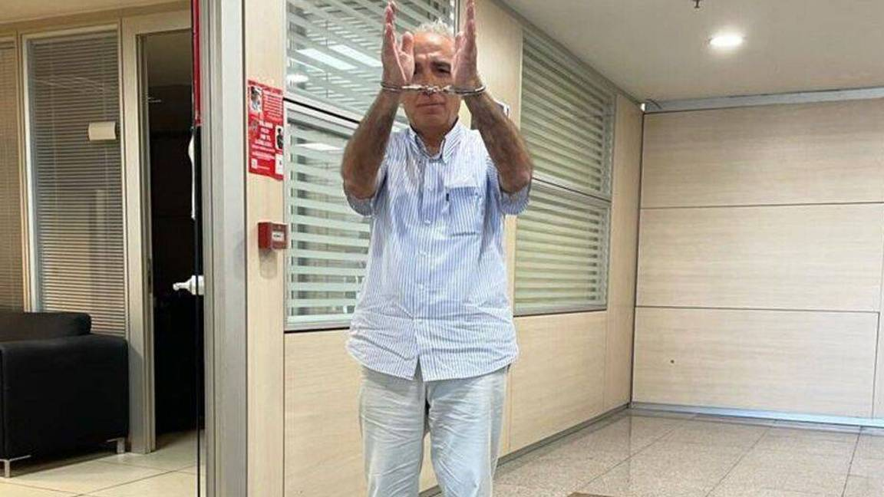
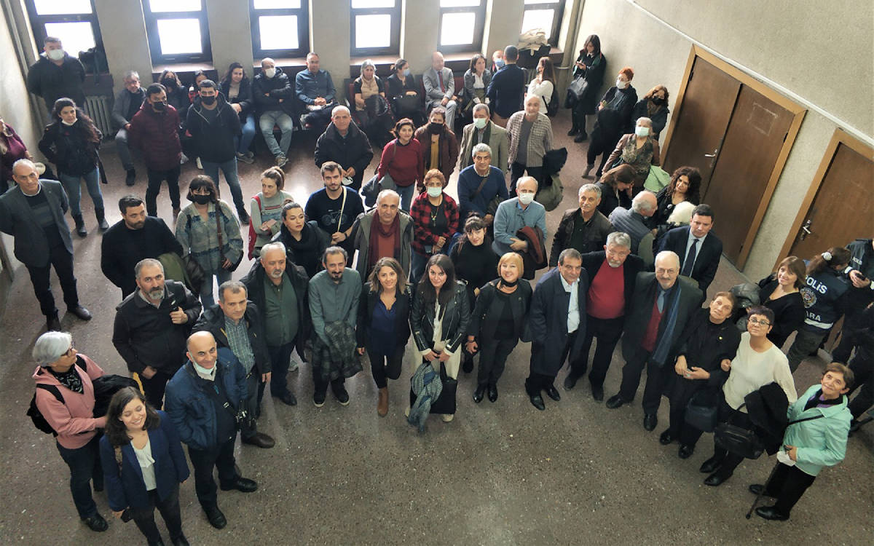
Selected examples: Öner and Türk group of cases
Charges | Name | Outcome
Article 7 § 2 of ATL (terrorist propaganda) | The Özgür Gündem solidarity case: Şebnem Korur Fincancı, Erol Önderoğlu, Ahmet Nesin | Acquitted, decision overturned, case pending
 | The Özgür Gündem solidarity case: Celalettin Can (78’s Initiative) | 1 year 3 months
 | The Özgür Gündem solidarity case: Dilşah Kocakaya | 1 year 3 months
 | Fatin Kanat (co-chair of Human Rights Association’s Ankara branch) | Acquittal
 | Chamber of Architect’s Ankara branch chair and executives: Tezcan Karakuş Candan, Muteber Osmanpaşaoğlu, Ece Yoltay, Nilay Evirgen Kabal | 1 year 8 months (overturned, acquitted)
 | Selçuk Kozağaçlı (Progressive Lawyers’ Association, ÇHD) | Acquittal

Slide 26
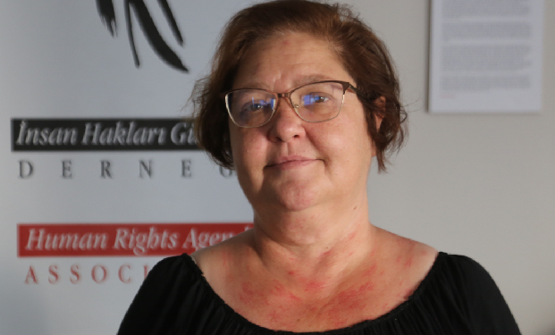
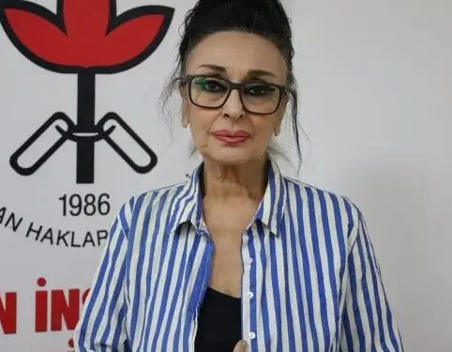
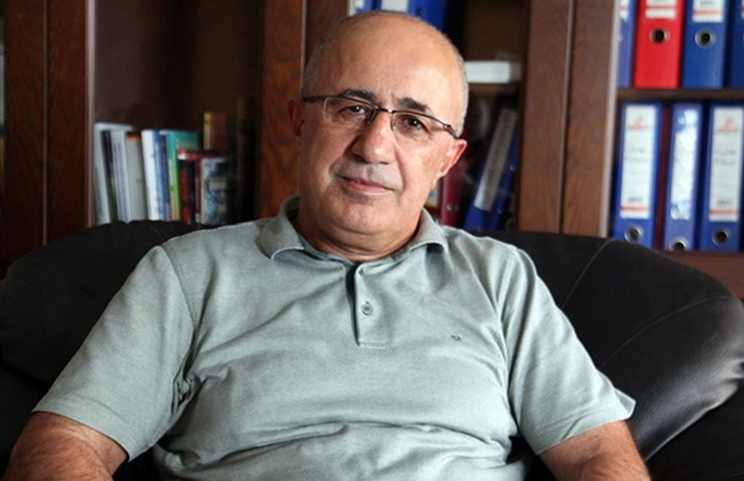
Selected examples: Öner and Türk group of cases
Charges | Name | Outcome
Article 6 § 1 of ATL (disclosing or publishing the identities of officials on counter-terrorism duties, or identifying such persons as targets) | Özlem Yılmaz (chairperson of the Board of Human Rights Agenda Association) and Eren Keskin (co-chair of the Human Rights Association, İHD) | Acquittal
 | Mehmet Emin Aktar (lawyer and former head of the Diyarbakır Bar Association) | Case pending
Article 216 of TCC (provoking the public to hatred, hostility or degrading) + Article 301 of TCC | Sezgin Tanrıkulu (rights defender, lawyer, member of Parliament) | Investigation pending
Article 216 of TCC (provoking the public to hatred, hostility or degrading) | Members of Eskişehir Women’s Defense Network (Kadın Savunma Ağı) | Investigation pending

Slide 27
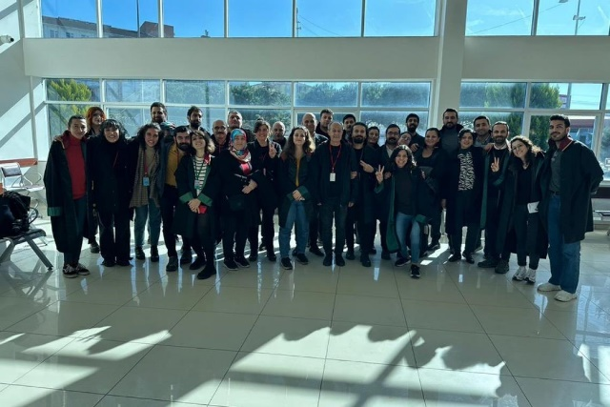
Selected examples: Işıkırık group
Charges | Name | Outcome
Article 314 of TCC (Membership of a terrorist orgaization) | GÖÇİZDER case: Bilal Yıldız and other rights defenders | Acquittal
 | Elif Tirenç İpek Ulaş and Fatma Gültekin (Rosa Women’s Association) | Acquittal
 | Narin Gezgör (Rosa Women’s Association) | 7 years 6 months (overturned, pending)
 | Adalet Kaya (Rosa Women’s Association and member of Parliament) | Case pending
 | Vetha Aydın Yüksel (Human Rights Association, İHD) | 6 years 3 monhts
 | Selma Atabey and Gönül Erden (Union of Health and Social Service Workers) | Case pending
 | Sibel Tekin (documentary filmmaker, journalist, academic) | Case pending
 | Ömer Işık (Human Rights Association, İHD) | 6 years 3 months
 | Lawyers in Diyarbakır | Case pending
 | Gülhan Kaya (Lawyers for Freedom Association, ÖHD) | Case pending
 | Sezin Uçar and Özlem Gümüştaş (Lawyers for Freedom Association, ÖHD) | Investigation pending
Article 220/7 of TCC (Knowingly and willingly aiding a terrorist organization) | Aryen Turan (Lawyers for Freedom Association, ÖHD) | Acquittal

Slide 28
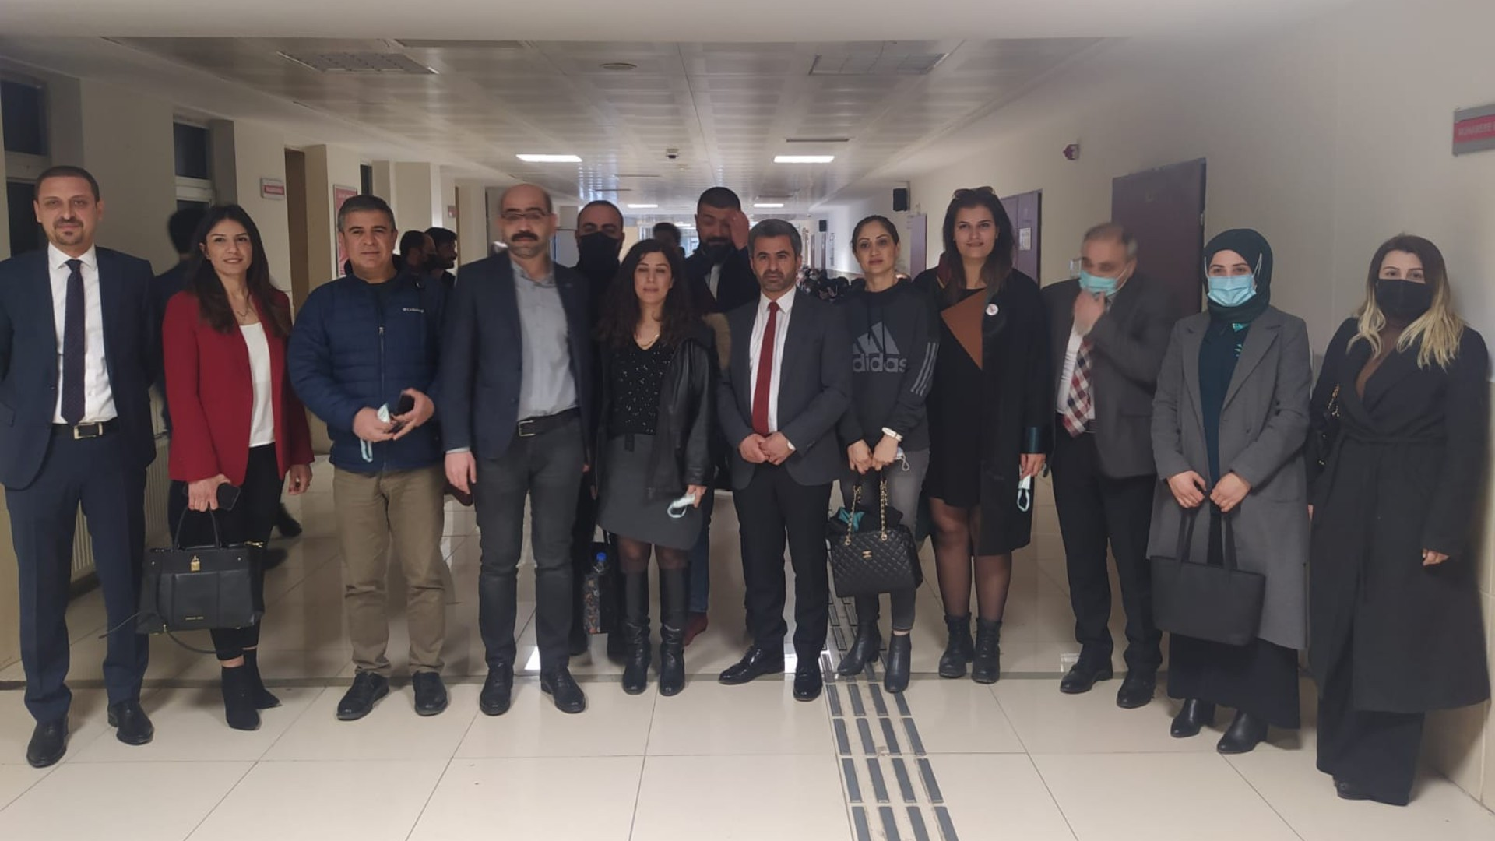
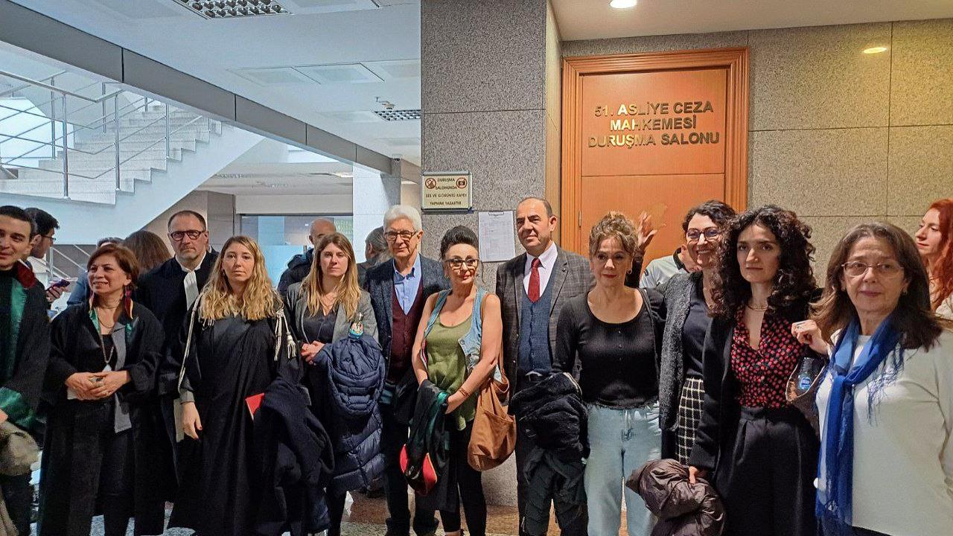
Selected examples: Altuğ Taner Akçam group
Charges | Name | Outcome
Article 301 of TCC (denigrating the Turkish nation, the Republic of Turkey, the institutions and organs of the state) | Diyarbakır Bar Association president and executive board members | Acquittal
 | Öztürk Türkdoğan (former co-chair of the Human Rights Association, İHD) | Acquittal
 | Eren Keskin (co-chair of the Human Rights Association, İHD) and Gülistan Yarkın (member of the İHD’s commission against racism and discrimination) | Case pending

Slide 29
Recommendations to the Committee of Ministers
We respectfully recommend the Committee of Ministers to:
Continue to examine the execution of the judgments in these case groups regularly and under enhanced procedure;
Examine and address the increasing use of interchangeable criminal provisions
Instruct the Secretariat to draft an interim decision if no tangible progress is made or detailed statistics are not provided by the next review
- Call on Turkey to:
Amend its definition of terrorism in the Anti-Terrorism Law in a way that is narrowly construed and compliant with Convention standards;
Repeal or substantially amend Articles 125, 215, 216, 314 of the Criminal Code, and Articles 6 and 7 of Anti-Terrorism Law, particularly by addressing their overbroad, vague, and unforeseeable wording;
Abolish Articles 220 § 6, 220 § 7, 299 and 301 of the Criminal Code which fail to fulfill the legality criteria, and closely monitor the legal proposals on Article 220 § 6 as the Committee of Ministers;
Submit detailed and separate statistical information covering last 5 years of the application of different Articles causing freedom of expression violations;
Take tangible steps to ensure that the Anti-Terrorism Law and the Criminal Code are not interpreted in a broad manner by the judiciary, that pre-trial detention decisions are not used as a punitive measure, and that Constitutional Court judgements are promptly implemented by all judicial and administrative bodies;
Stop targeting, harassing and intimidating journalists and HRDs by subjecting them to judicial and administrative measures.

