Slide 1


Ilias and Ahmed v. Hungary
App. No. 47287/15 [GC]
András Léderer
Hungarian Helsinki Committee

Slide 2

Findings of the Court
Domestic legal instruments in force leading to repeated violations
Submitted Action Reports
How these translate to the reality on the ground
Recommendations

Slide 3
Violation found – Article 3 procedural limb concerning the applicants’ return to Serbia
„[…] by relying on a general presumption of “safe third country”, which was not based on a thorough assessment of the risk of lack of effective access to asylum proceedings in Serbia, including the risk of refoulement, and by
inducing them to enter Serbia illegally instead of negotiating an orderly return”

Slide 4

The general presumption concerning Serbia

Slide 5
Legal instruments in force I.
Gov’t decree 191/2015 (21 July) on the list of safe countries of origin and safe third countries
Section 51(2)(f) of the Asylum Act (concept of safe transit country, found incompatible with EU law in C-564/18)

Slide 6
Legal instruments in force II.
Section 5(1)(b) of the State Borders Act (legalisation of collective expulsions, see related case Shahzad v. Hungary 12625/17, violation of A4P4 and Article 13 in conjunction with A4P4)
Sections 267-275 of the Transitional Act of 2020 and related implementing gov’t decrees (the embassy system)

Slide 7

Government Action Reports

Slide 8
The government does not foresee any change
21/10/2020:
As the transit zones were closed following C-924/19 and C-925/19 PPU, the physical space whence the removal in breach of Article 3 took place does not exist any longer
26/10/2021:
As the transit zones were closed following C-924/19 and C-925/19 PPU, the physical space whence the removal in breach of Article 3 took place does not exist any longer
Unlawful inadmissibility ground leading to mass rejections and removals not applied (Section 51(2)(f) of the Asylum Act)

Slide 9
Automatic removals to Serbia continue

Slide 10

Title goes here
Section 5(1)(b) of the State Borders Act prescribes the automatic removal of unlawfully staying foreigners to the Serbian side of the border fence without
Identification
Individualised procedure
Formal decision
Contacting the Serbian authorities

Slide 11
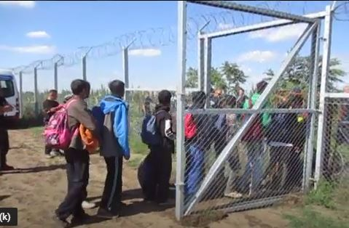

Shahzad v. Hungary

Slide 12
„Access” to asylum – the embassy system
Sections 267-275 of the Transitional Act introduces a pre-approval system against which no remedy is available
Since May 2020, 86 statements of intent were sent to the asylum authority, 12 of these were approved
Those fleeing Ukraine who do not fall under the temporary protection scheme are also sent to Serbia
Regular denial of access to asylum on the territory, related domestic court decisions sabotaged or not implemented

Slide 13
Recommendations

Slide 14
The government shall provide information on
The state of play of the reform of the asylum system allegedly underway since at least 20 October 2020, especially how it will contribute to the implementation of the general measures identified in the judgment
Until the introduction of this reform, how authorities discharge their duties under Article 3 in the framework of the embassy system in cases where prospective applicants are staying in Hungary

Slide 15
The government shall
Conduct a new assessment on the situation of asylum-seekers in Serbia
Repeal Section 51(2)(f) of the Asylum Act and review the related amendment to the Fundamental Law
Repeal Section 5(1)(b) of the State Borders Act
Amend Section 51(2)(e) and Section 51/A of the Asylum Act to ensure that the „safe third country” concept is applied in cases where the third country ensures access to territory and procedure
Take measures that ensure effective access to territory and procedure at the borders and on the territory of Hungary regardless of their migratory status

Slide 16

Thank you
For your attention!

