Slide 1
COMMUNICATION in accordance with Rule 9.2. of the Rules of the Committtee of Ministers regarding the supervision of the execution of judgments and of terms of friendly settlements VASILESCU Group v. BELGIUM (request no. 64682/12)

Slide 2
“VASILESCU group v. BELGIUM”
VASILESCU v. BELGIUM – judgment of 25 November 2014
(leading case – application no. 64682/12)
(Antwerp and Merksplas prison)
SYLLA and NOLLOMONT – judgment of 16 May 2017
(repetitive case – applications nos. 37768/13 and 36467/14
(Forest and Lantin prison)
PÎRJOLEANU – judgment of 16 March 2021
(repetitive case – application no. 26404/18)
(Antwerp prison)

Slide 3
VASILESCU v. BELGIUM
§ 127 (…) The Court notes that the problems of prison overcrowding in Belgium, as well as the problems of hygiene and ageing prison infrastructure are of a structural nature and do not only concern the personal situation of the applicant. (…)
(…) none of the remedies invoked by the Belgian Government could be considered effective remedies to be exhausted.

Slide 4
VASILESCU v. BELGIUM
§ 128 In this context, the Court recommends that the Belgian State consider the adoption of general measures. On the one hand, measures should be taken to guarantee detainees conditions of detention in accordance with Article 3 of the Convention. On the other hand, detainees should have recourse to prevent the continuation of an alleged violation or to enable the person concerned to obtain an improvement in his conditions of detention.

Slide 5
1398th meeting, 9-11 March 2021 (DH) H46-3 Vasilescu group v. Belgium (Application No. 64682/12) CM/Del/Dec(2021)1398/H46-3 11 March 2021
The Deputies
1. recalled that these cases concerned structural problems of prison overcrowding and poor material conditions of detention, and the absence of an effective domestic remedy to raise complaints in this regard;

Slide 6
1398th meeting, 9-11 March 2021 (DH) H46-3 Vasilescu group v. Belgium (Application No. 64682/12) CM/Del/Dec(2021)1398/H46-3 11 March 2021
The Deputies
3. noted that, despite progress since the facts of the Vasilescu case, the authorities indicate that they must continue to adopt measures and conduct reflections in order to put an end to prison overcrowding and to ensure conditions of detention in accordance with international standards; therefore invited the authorities to concretise the necessary measures and reflections as quickly as possible, by regularly assessing the situation and planning all budgets for their effective implementation, and to keep the Committee informed;

Slide 7
1398th meeting, 9-11 March 2021 (DH) H46-3 Vasilescu group v. Belgium (Application No. 64682/12) CM/Del/Dec(2021)1398/H46-3 11 March 2021
The Deputies
5. regarding overcrowding, noting with concern that the latest annual rate is the highest since 2014 and that many remand centers remain very overcrowded, exhorted the authorities to urgently put in place any solution to better distribute the detainees, whatever their detention regime

Slide 8
Action Plan of March 2022
“Toutefois, les actions menées par les autorités doivent se poursuivre afin de permettre, à terme, de mettre fin à la surpopulation et d’assurer des conditions aux détenus conformes aux standards internationaux.”
status quo: “the authorities indicate that they must continue to adopt measures and conduct reflections in order to put an end to prison overcrowding and to ensure conditions of detention in accordance with international standards”
“Enfin, pour les maisons d’arrêt, où les entrées sont décidées soit par le juge d’instruction soit par le parquet, des réflexions doivent être menées pour déterminer les possibilités d’une meilleure répartition.”
status quo: the authorities indicate that, regarding remand centers, they must continue to conduct reflections in order to better distribute the detainees

Slide 9
VASILESCU v. BELGIUM
insufficient living space
floor mattress
lack of privacy in the use of toilets
exposure to passive smoking
reduced time out of cell

Slide 10
photos taken in Antwerp prison at the end of December 2021 published in Knack magazine on 5 January 2022 © Filip Van Roe

Slide 11
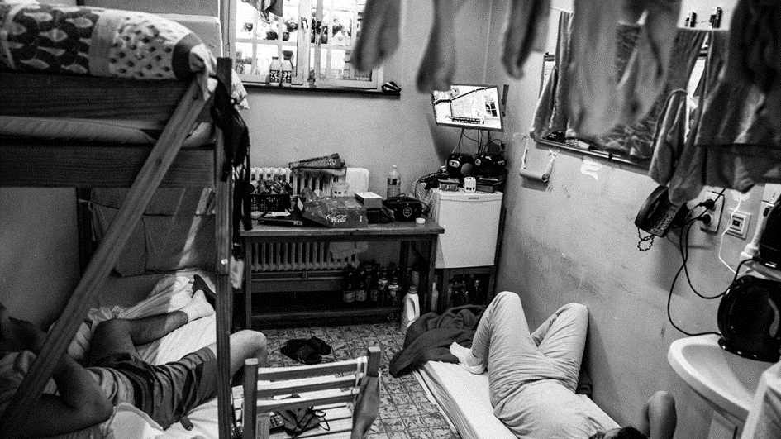

Slide 12
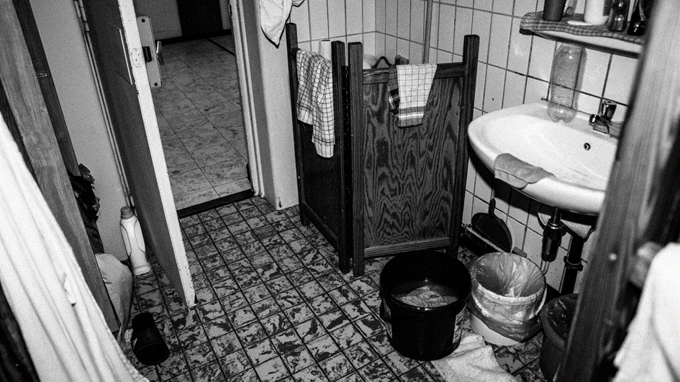

Slide 13
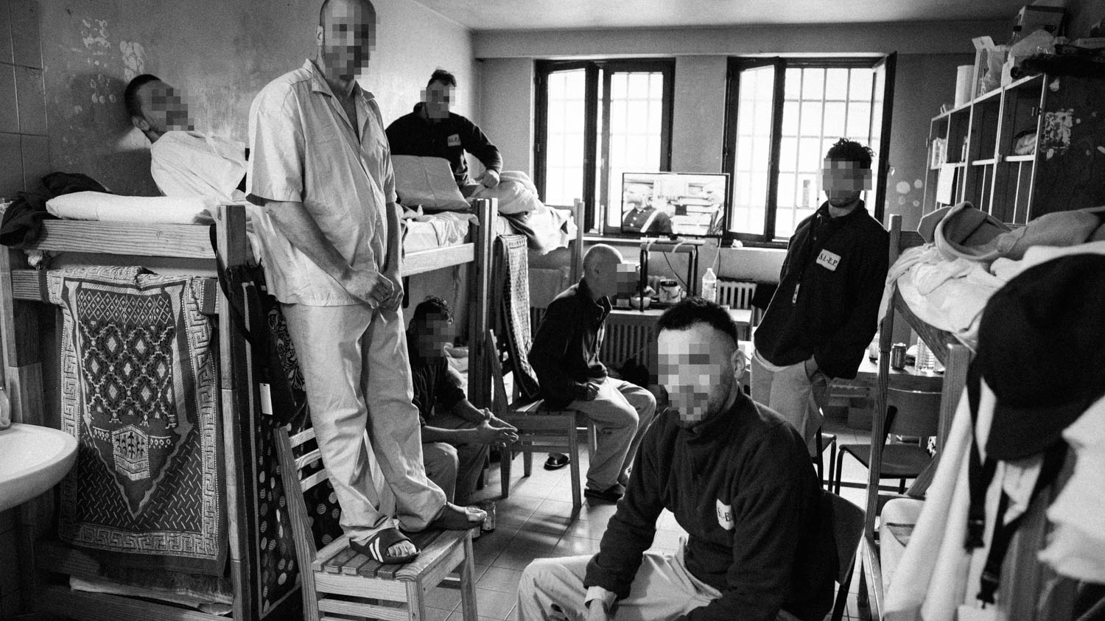

Slide 16
First Action Plan (February 2016): “overcrowding in Antwerp prison has decreased (520 detainees) so that every detainee has a bed. In the period in which mister Vasilescu was detained, Antwerp prison counted 687 detainees.”

Slide 17
Overcrowding in Antwerp prison (male) operational capacity: 391 2022, week 1-20 (January – 16 May 2022)

Slide 18
Structural problem of overcrowding Average daily prison population / capacity as referred to in Action Plan March 2022 (all prisons – average prison population in 2021: 10 438 detainees)

Slide 19
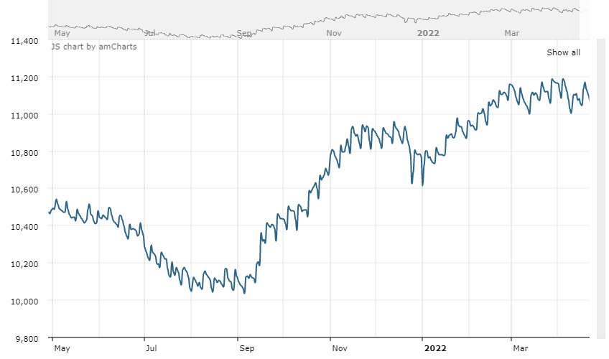
Evolution of prison overcrowding from day to day (all prisons; May 2021-April 2022)

Slide 21
Detainees sleeping on a mattress on the ground (17 May 2022)
Antwerp 60 detainees
Ghent 56 detainees
Bruges 20 detainees
Dendermonde 2 detainees
Oudenaarde 4 detainees
Wallonia 10 newly detained persons placed in isolation cell awaiting a normal cell
In cells where an additional bed has been added, the sanitary facility in the cell has not been arranged. Some prisons have asked for extra folding screens.

Slide 23
Solutions announced by the Minister of Justice (not mentioned in the Action Plan)
a better distribution of detainees between prisons and the creation of additional capacity through the installation of additional beds
an increase in prison capacity in 2022 and in the longer term (Action Plan: La Belgique poursuit (…) son travail de réduction de la population carcérale en vue d’atteindre un total de moins de 10 000 détenus pour l’ensemble des établissements pénitentiaires en Belgique.”)
a new policy for the execution of sentences whereby (so-called ‘short’) sentences less than three years will be executed more systematically; this should refrain judges to inflict severe sentences to be sure that the condemned person will stay for a while in prison and would reduce the use of pre-trial detention as a guarantee that the accused will serving at least partially his sentence in prison

Slide 24
Execution of prison sentences – actual situation
sentence of 4 months or less immediate provisional release
+ 4 months - 7 months provisional release after 1 month in prison or under electronic monitoring
+ 7 months – 1 year provisional release after 2 months in prison or under electronic monitoring
+ 1 year – 2 years provisional release after 4 months in prison or under electronic monitoring
+ 2 years – 3 years provisional release after 8 months in prison or under electronic monitoring
(see communication of Belgian government of 06.12.2017: measures taken to reduce prison overcrowding)

Slide 25
Execution of prison sentences in the future
sentences no longer than 18 months: conditional release can be immediately asked to the penalty execution judge and sentence prison is not executed until decision of sentence enforcement judge
sentences of more than 18 months: sentence must be served in prison as long as sentence enforcement judge did not allow an alternative punishment mode (‘reduced detention’ or electronic monitoring)

Slide 26
Additional capacity to be realised
actual operational capacity: 9 679 places
Haren – new prison to replace Saint-Gilles, Forest, Berkendael (additional capacity: 106 places) (september 2022)
Dendermonde – new prison to replace old one (additional capacity: 276 places) (2022)
Saint-Gilles and ‘old’ Dendermonde partially and temporarily maintained (350 places)
Berkendael temporarily maintained as ‘detention house’ (60 places)
Ypres – renovation (56 additional places) (2023) (?)
‘detention houses’ (720 places – 60 places in Berkendael already mentionned) (?)
‘transition houses’ (100 places) (?)
additional capacity to be realised in 2022-2024: 1 608 places (in total: 11 287 places)
Vresse-sur-Semois – new prison (312 places) (2026)
Bourg-Léopold – new prison (280 places) (2026)
Jamioulx – additional capacity (50 places) (2027)
Ruiselede – additional capacity (50 places) (2028)
additional capacity in the longer term (including capacity to be realised in 2022-2024): 1 950 places (in total: 11 629 places)

Slide 27
Action Plans of September 2019, March 2021 and March 2022
New prisons (Masterplans 2008 & 2012)
Haren 2022 2022 2022
Dendermonde - 2022 2022
Antwerp 2023 2024 2024/2025
New prisons (Masterplan 2016)
Bourg-Léopold 2024 2025 2026
Vresse-sur-Semois 2024 2025 2026
Verviers & Liège 2024 2026 2027
Paifve 2025 2026 2027

Slide 28
Action Plan of March 2022
“La Belgique poursuit, par ailleurs, son travail de réduction de la population carcérale en vue d’atteindre un total de moins de 10 000 détenus pour l’ensemble des établissements pénitentiaires en Belgique.”
Does the government really continues its work of reducing the prison population with a view to reaching a total of less than 10 000 prisoners for all penitentiaries in Belgium?

Slide 29
31st General Report of the CPT (April 2022)
104. The CPT further notes that in certain European countries substantial sums are being spent on building new prisons and/or adopting policies to expand the capacity of the prison estate. The CPT is firmly of the view that constructing new prisons and/or permitting prison population inflation will not provide a lasting solution to the problem of overcrowding.

Slide 30
A new policy for the execution of sentences as solution for prison overcrowding?
scientific support for the assumption that the execution of ‘short’ sentences will, in the long term, have the effect of reducing recidivism and countering penal inflation and, finally, of reducing prison overcrowding?
number of extra detainees in a year: 720 detainees (if all ‘short’ sentences would be executed – new policy coming into force on 1st September 2022 – 1st September 2023)
“need for an integrated and systemic approach to overcrowding, a more solid foundation and better evaluation of the policy, the implementation of legislation, the creation of the necessary conditions for this and a better harmonisation with other public services and the judiciary, within the framework of a broader reform of criminal law and criminal procedure” (Cour des comptes, January 2012)

Slide 31
31st General Report of the CPT (April 2022)
107. The CPT wishes to recall that prison overcrowding is neither just a problem for prison governors and prison administrations to solve, nor one that Governments can tackle alone. Instead, the CPT’s experience has shown that combating prison overcrowding requires a systemic approach and concerted action by all relevant stakeholders. As stated in the Council of Europe’s White Paper on prison overcrowding: “There should be constant dialogue and common understanding and action involving policy makers, legislators, judges, prosecutors and prison and probation managers in each member State”.

Slide 32
1398th meeting, 9-11 March 2021 (DH) H46-3 Vasilescu group v. Belgium (Application No. 64682/12) CM/Del/Dec(2021)1398/H46-3 11 March 2021
4. importance of providing the most complete and up-to-date information and statistics possible – no progress
6. wider use of all alternatives to detention and adjustments to prison sentences – no progress
7. measures to improve detention conditions, in particular the partitioning of sanitary facilities and the establishment of sufficient out-of-cell activities for all detainees, including in remand centers – no progress

Slide 33
1398th meeting, 9-11 March 2021 (DH) H46-3 Vasilescu group v. Belgium (Application No. 64682/12) CM/Del/Dec(2021)1398/H46-3 11 March 2021
8. with regard to the effective remedy, noted with interest that a compensatory remedy seems to be developing in practice; noted, on the other hand, with concern the absence of any relevant development demonstrating the existence of an effective preventive remedy and therefore urged the authorities to put in place, without further delay, a specific remedy, in accordance with the requirements of the Convention, drawing on remedies existing in other member States; decided, in the absence of tangible progress in this regard by the end of March 2022, to instruct the Secretariat to prepare a draft interim resolution for consideration at their DH meeting in June 2022.

Slide 34
Effective preventive remedy?
rare cases in which an investigating judge of investigating court has released a suspect because of the conditions of detention
appeal to the interim relief judge is not an effective preventive remedy (Vasilescu, Sylla and Nollomont, Pîrjoleanu)
conditions of detention are not taken into account for the decision on placement or transfer to a prison, nor for judging the appeal against that decision (anyway: no single decision in that way)
‘droit de plainte’: right to complain a decision of the prison direction, not the material conditions of detention as such; no competence for granting a financial compensation
no progress as regards the implementation of a specific effective preventive remedy

Slide 35
Proposals for additional recommendations to be made
immediate reduction of prison overcrowding so that every prisoner has at least a bed
continuous monitoring of the evolution of prison population and reinforcement of statistical services; preparation and implementation of prison policy on the basis of accurate data
establishment of the Conseil pénitentiaire (Act of 23 March 2019) with the mission to evaluate the social and scientific relevance of the prison policy pursued
legislation that puts an upper limit to the number of prisoners
implementation of an effective remedy

Slide 36
Legislative proposal ‘Dupont’ (Doc. parl. Chambre 2000-2001, n° 50-1076/1, p. 292) This proposal lead to the ‘Principles Act’ of 12 January 2005 – but Art. 15 of this proposal was not adopted Art. 15. § 1er. Le Roi détermine la capacité d’occupation maximale de chaque prison ou de chaque section de prison. La capacité maximale est déterminée en tenant compte des besoins en espaces de séjour (…), en fonction de la destination de la prison ou de la section de prison. § 2. La capacité maximale d’un établissement pénitentiaire ou d’une section, telle que déterminée par le Roi, ne peut être dépassée. Si l’exécution des peines privatives de liberté dans le respect des dispositions du §1er ne peut être garantie, il est possible, lorsque des motifs de sécurité publique ne s’y opposent pas, de décider que les peines privatives de liberté dont la durée exécutoire totale atteint maximum un an et dont l’exécution n’a pas encore commencé, ne seront pas exécutées ou le seront selon une modalité d’exécution pénale autre que l’enfermement, ce sur la base de critères spécifiquement élaborés à cet effet par le Collège des Procureurs généraux. (…)

Slide 37
31st General Report of the CPT (April 2022)
102. The Committee considers that, for every prison, there should be an absolute upper limit for the number of prisoners (“numerus clausus”), in order to guarantee the minimum standard in terms of living space, namely 6m² per person in single cells and 4m² per person in multiple-occupancy cells (excluding the sanitary annexe). Thus, whenever a prison has reached that limit, appropriate steps must be taken by the relevant authorities to ensure that a person, who has been newly remanded in custody or sentenced to imprisonment, is offered acceptable conditions of detention (including in terms of living space).

Slide 38
bart.detemmerman@ctrg-belgium.be

