Slide 1

Execution of Identoba Group Cases
Toby Collis
Davit Javakhishvili

Slide 2
Summary of the Group
degrading treatment of the applicants on account of abusive and humiliating police conduct, motivated by homophobic and/or transphobic hatred; and/or
authorities’ failure to provide adequate protection against, and in some instances official acquiescence and connivance in, inhuman and degrading treatment inflicted by private individuals on LGBTI activists and Jehovah’s Witnesses; and/or
absence of effective investigations into these facts, including lack of investigation into discriminatory motives, including issues of discrimination on LGBTI status, religious status (Jehovah’s Witness/ Muslim groups)
A number of cases closed, but 3 remain open – see following:

Slide 3
Aghdgomelashvili and Japaridze v. Georgia
Police raid on NGO: 17 plain clothed police officers raided office w/o warrant. Degrading and homophobic insults, and strip searches.
At the time of judgment no meaningful progress on investigation of police officers.
Violation procedural obligation under Art 3: “…authorities’ long-standing inability – which can also be read as unwillingness – to examine the role played by homophobic and/or transphobic motives in the alleged police abuse. A…pressing need to conduct a meaningful inquiry …given the well-documented hostility against the LGBT community in the country at the material time…”
Violation substantive obligation under Art 3 combined with Art 14: “conduct … was motivated by homophobic and/or transphobic hatred and must necessarily have aroused in the applicants feelings of fear, anguish and insecurity.”

Slide 4
WISG and Others v. Georgia
Applicants 35 individuals and 2 LGBTI NGOs. In 2013, planned rally on IDAHO day and contacted authorities in advance. Applicants subject to violence by counterprotestors, with evidence police were tolerating, and insufficient police presence. Criminal investigation led to 2 sets of criminal proceedings, leading to acquittals, and pending investigations, and small administrative fines.
Procedural violation of Art 3 and 14: lack of independence of investigative body; investigations led to no tangible results
Failure to protect:
  Heightened obligation to provide protection
  Response was inadequate
  Evidence of official connivance,
Failures in planning violated Articles 11 and 14 of the Convention

Slide 5
WISG and Others v. Georgia (App. no. 73204/13)
Judgment 2021
  Procedural violation of Art 3 and 14: lack of independence of investigative body; investigations led to no tangible results
  Failure to protect:
    Heightened obligation to provide protection
    Response was inadequate
    Evidence of official connivance,
  Shaved beard: humiliated the applicant
  Failures in planning violated Articles 11 and 14 of the Convention

Slide 6
Mikeladze and Others v Georgia
  Arrests of applicants during protests of conversion of Mosque to public library
  Allegations that the police used excessive force during the arrests and shouted insults. Applicants lodged complaints about ill-treatment by police officers
  Judgment in 2021
    Procedural violation of Art 3 and 14: investigation limited and not independent and failed to investigate allegations of derogatory language.

Slide 7
Summary of Action Plans/ Reports
Government provided early action plans in 2016-17
Since 2018, provided yearly Action Report. In most recent (for Dec 2023 meeting) asks to close supervision.
Outlines recent individual measures – in summary investigations ongoing, and 2 persons charged in Mikeladze case. No police officers in other cases charged or identified.

Slide 8
Summary of Action Plans/ Reports
  On general measures:
    Zero tolerance messages - it is a ‘priority’ and an ‘ongoing process’
    Right to peaceful assembly –authorities cooperate on organisation of events. Notes unable to hold July 8 2023 event: “a particularly large number of counter demonstrators made it complicated to control them in a wide area”
    Investigation of previous marches –investigations are ongoing
    Specialised investigation of hate crimes – Creation of department of human rights protection; hate crime training; only specialised investigators/ prosecutors investigate hate crimes
    Collecting data - memorandum signed on collection of data. Complete data for 2022 was published. Outlines SOGI and hate related to prosecutions, arrests and victims.
    The National Human Rights Strategy and Action Plan – strategy approved and adopted in 2023, now working on action plan

Slide 9
Execution of Individual measures
Aghdgomelashvili and Japaridze
To date, no individual has been determined charged or convicted.
WISG
Not a single individual has been found criminally responsible or held to account.
Victims have not been granted adequate access to pertinent information or documentation.
The criminal responsibility of police officers will be excluded due to the expiration of the statute of limitations on December 15, 2023.
Prosecutor declined request for the acknowledgment of all those interviewed as victims.
Mikeladze
No investigative activity from 2015 to 2021. Criminal charges were brought against two former police officers. Remaining applicants: investigation ongoing and not yet granted victim status.

Slide 10
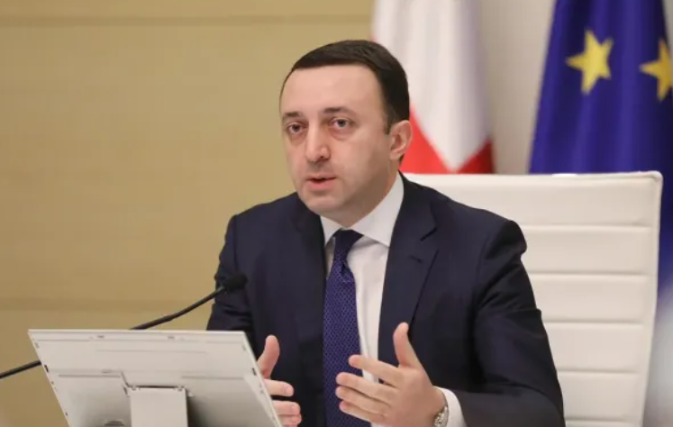
General Measures: Zero-tolerance messages
Continues to be anti-LGBT sentiment and statements form the highest points of Government
“March should not take place as it is unacceptable to the majority of the population”, then he followed up on this by saying “We have our traditions, rules and everyone should respect our rules and traditions. … I would also like to point out that, unfortunately, behind the organizers ... are revanchist, radical groups. In particular, the radical opposition led by Saakashvili. They are involved, absolutely, I declare this with full responsibility, that they are organizing this march.”
Prime Minister- Irakli Garibashvili
Shortly after, the angry mob started to attack journalists and offices of various NGOs

Slide 11
Chilling effect on the right to freedom of peaceful assembly
5 July 2021 -Publicly organized violent attacks on journalists because of their support for LGBTQI
8 July 2023 - At least 2000 anti-LGBTIQ+ individuals attacked the NGO Tbilisi Pride’s Pride Festival in Tbilisi, Georgia
Tbilisi Pride had to cancel all the Pride-related events following the attack;
None of the organizers of the hate groups have been charged;
No investigation has been initiated into the alleged violations of State itself.
In 2022 Tbilisi pride decided not to hold a March of Dignity – Chilling effect
Due to the large-scale aggression of violent groups, the “Pride March” was canceled
More than 50 journalists were beaten and some were hospitalized while covering a protest against a gay rights rally in Georgia's capital, Tbilisi;
None of the organizers or participants of the hate groups have been charged.

Slide 12
Deficiencies of the investigation of hate crimes and refusal of establishment specialized investigative unit
The investigative units are not launching investigations.
The government refuses to initiate investigations with respect to the omissions of police officers and the negligence of MIA's high-ranking officials.
The prosecutor's office continues to refuse to grant victim status or involve victims.
The government has not established a specialized investigative unit.
Discriminatory motive is not included as an aggravating factor for administrative offences.

Slide 13
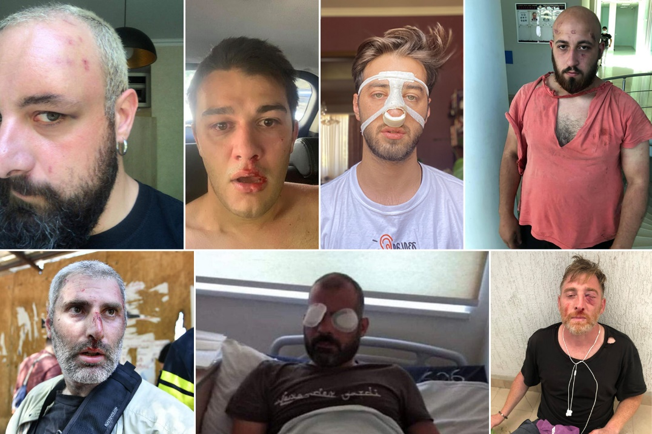
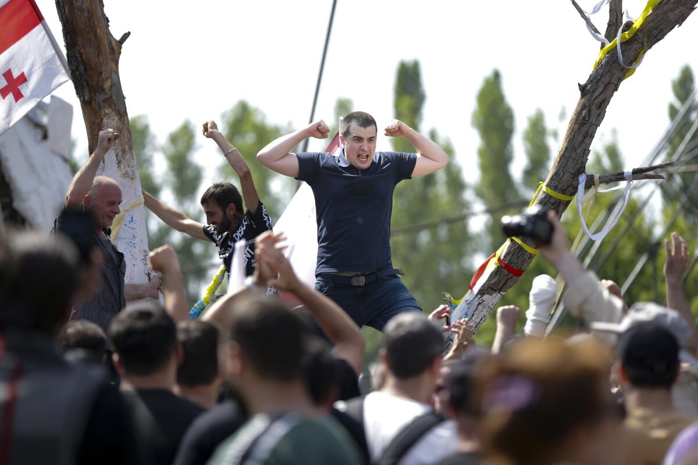
Results of impunity
Aleksandre Lashkarava, a cameraman severely beaten by members of a hate group, passed away soon after event. The investigation is still ongoing.
Some journalists have left the country, while others have left the profession.
Due to the physical injuries sustained, cameraman Ilia Tvaliashvili suffered permanent negative consequences on his body and is under restricted work
The organizers of hate groups continue to publicly plan assaults on Pride events.
None of them have been charged or detained.
The legal representatives of the victims do not even have access to the criminal case materials related to the organizers.

Slide 14

The National Human Rights Strategy and Action Plan
“The National Strategy for the Protection of Human Rights for 2022-2030 was adopted by the Parliament in March 2023 without including the needs of the LGBTI community.
Public Defender of Georgia

Slide 15
Recommendations
Individual measures
Authorities must reclassify the crimes commensurate with their seriousness; and
The responsible authorities should carry out an effective, timely, independent investigation, including identification of police officers involved, and ensure that statute of limitations do not lead to impunity;
Authorities should grant victim status and adequate victim participation.

Slide 16
Recommendations
Together with civil society actors, the State should establish the measures necessary to enable the safe and peaceful gatherings of LGBTQI activists and take preventive measures to deter violence, hatred and discriminatory attitudes and behaviour.
The Government must reconsider its official tolerance of the repetitive violent acts committed by organizers of hate crimes, and discontinue anti-LGTBQI sentiments;
Authorities must observe its positive obligation to protect LBGTQI persons at events from violence and effectively investigate these incidents, particularly those arising out of the violence on 5-6 July 2021, and 08 July 2023, and particularly the organisers of the events;
Authorities must create a specialized investigative unit capable of investigating the hate crimes;
General measures

Slide 17
Questions

