Slide 1


EIN Briefing to the
Committee of Ministers
Strasbourg, 27 February 2023
Baka v. Hungary case
The chilling effect on the
freedom of expression of
Hungarian judges

Slide 2
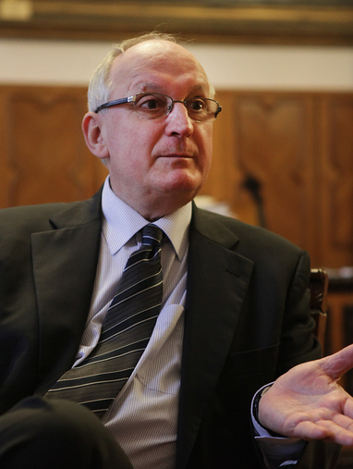
Baka v. Hungary case
Violation of Article 6 ~ undue and premature termination of Judge Baka’s mandate as President of the Supreme Court through ad hominem legislative acts of constitutional rank and therefore beyond judicial control
Violation of Article 10 ~ was prompted by views and criticisms he expressed on reforms affecting the judiciary.
Exerting a ’chilling effect’ on other judges discouraging them from participating in public debate on legislative reforms affecting the judiciary and on issues concerning the independence of the judiciary

Slide 3
Systematic undermining
systematic undermining of the independence of the judiciary since 2011
via legislation (i) the reforms criticized by Mr. Baka (ii) forced retirement of judges (iii) separate administrative court system (iv) series of omnibus acts
via uncontrolled court administration measures (i) weakened checks and balances (ii) political appointees holding uncontrolled powers (iii) a court administration system prone to misuse of management powers
sustained internal and external pressure on individual judges
capable to exert chilling effect on judges

Slide 4
Chilling effect
prevents judges from speaking out publicly against measures undermining the independence of the judiciary
measures expected by CM decisions (execution pending since 2017)
  - take measures to lift and countervail the chilling effect
  - the situation has not been addressed but rather aggravated
  - take measures to counter the chilling effect
  - fully guarantee and safeguard judges freedom of expression
  - evaluate the domestic legislation regarding guarantees against undue interferences

Slide 5
Instead of lifting, amplifying
Manifest non-completion
no general measures have been taken
no action plan prepared
the authorities’ own undertaking to evaluate domestic legislation was not fulfilled
Amplification of the chilling effect
  undermining the credibility of the judiciary as a whole through public statements of high-ranking politicians
  attacks on individual judges who dare to speak out
  smear campaigns to discredit individual judges
  administrative pressure
  CM INTERIM RESOLUTION OF 2022

Slide 6
Smear campaigns of 2022
In 2022 two massive smear campaigns were targeted against individual judges as members of the National Judicial Council
The context
rule of law conditionality proceeding against Hungary
debate over the approval of the RRF of Hungary
heightened conflicts between administrative leaders and the NJC
  - unlawful appointment practice, controversial secondments
  - high-profil corruption case reaching court administration

Slide 7
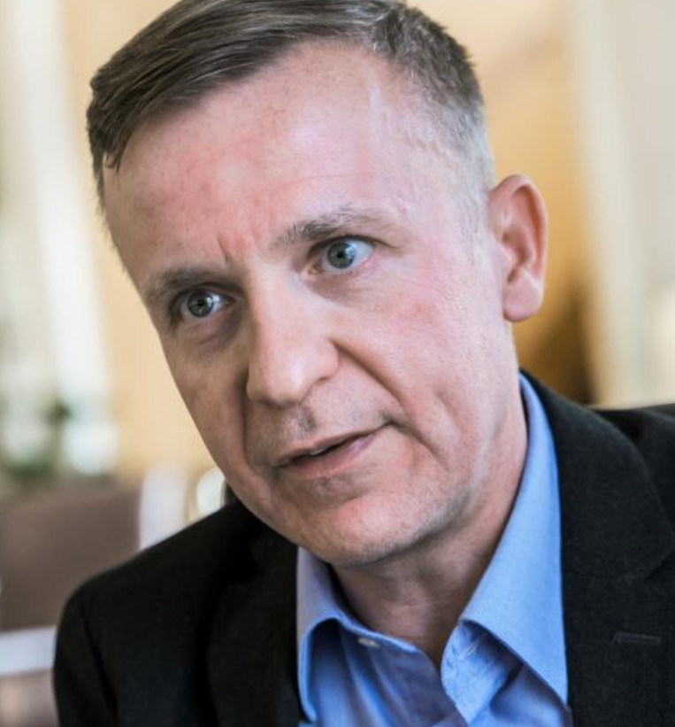
First wave ~ Aug 2022
judge Vasvári (spokesperson of the NJC)
public statement in ‘The Guardian’
„we have been witnessing
external and internal influence attempts”
„we just want a transparent and meritocratic system”
defamatory campaign in the governmental propaganda media for one week
„blood judge” „judge of terror”
depicting the NJC as „a putty club”

Slide 8
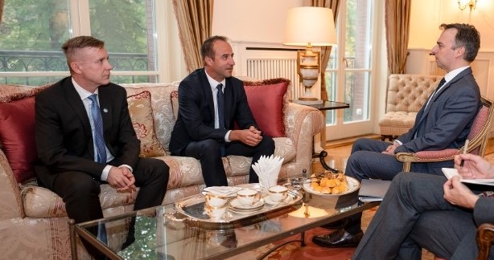
US Amb. David Pressman publicly thanked members of the NJC for the informative discussion about the NJC’s critical role in Hungary’s judicial system

Slide 9
Second wave ~ Oct-Dec 2022
targeted against
judge Vasvári (spokesperson of the NJC)
judge Matusik (international rep.)
massive smear campaign for over a month
more than 450 publications
consciuously built up and boosted
launched in an anonymous blog of the right-wing media
joined by pro-government think tanks
discrediting members of the NJC as judges
questioning their independence

Slide 10
Pro-active participation of authorities
Kúria President – „I do not wish to share responsibility for discrediting the judiciary for the sole benefit of group interests”
NOJ President – „the justification and lawfulness of the meeting in question are clearly disputable and can therefore be subject to well-founded criticism”
High-ranking ruling party MP – „I think that a judge who consulted with the American ambassador […] is not likely to be able to give an unbiased judgment on a matter of different values”
Prime Minister’s Office – „some members of the NJC unprecedentedly stretched their limits, only out of personal interest.”

Slide 11
Protection denied
the NJC requested protection in vain on several occasions
Hungarian and international associations of judges expressed solidarity
Protection was expressly refused by the powerful administrative leaders
- Kúria President „I am the President of the Kúria, and if any judge of the Kúria is attacked, I raise my voice without exception. […] With respect to other courts, I have no responsibilty to do so.”
- NOJ President „It is the public stage that creates the special status of a public actor.”

Slide 12
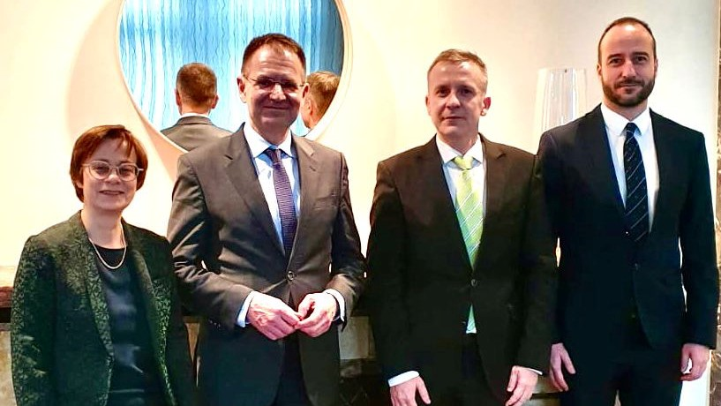
February 2022 ~ German Amb. Julia Gross and German Public Prosecutor Peter Frank meeting representatives of the NJC

Slide 13
The Code of Ethics
the Kúria President challenged the new Code of Ethics before the Constitutional Court
questioning the legal authority of the NJC to adopt the Code of Ethics
the Code significantly extends the freedom of expression of judges especially with respect to criticising legislation
special ethical rules should not apply to judicial leaders

Slide 14
Recommendations
  Hungarian authorities should
  - evaluate domestic legislation with respect to guarantees and safeguards protecting judges from undue interferences
  - address the issue of judicial independence holistically and comprehensively
  - refrain from and condemn any public harassment, intimidation or retaliation against judges, and provide effective protection from personal attacks against judges
- abstain from any public critique, recommendation, suggestion or solicitation regarding court decisions that may constitute direct or indirect influence on pending court proceedings or otherwise undermine the independence of individual judges in their decision-making

