Slide 1


ERIKA FARKAS
EIN Briefing to the Committee of Ministers
Strasbourg, 27 November 2023
Baka v. Hungary case
and the chilling effect on the
freedom of expression of judges

Slide 2
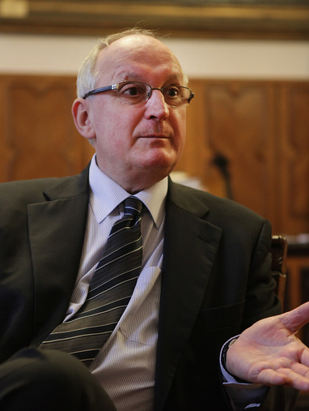
Baka v. Hungary case
2016
Violation of Article 6 ~ undue and premature termination of Judge Baka’s mandate as President of the Supreme Court through ad hominem legislative acts of constitutional rank and therefore beyond judicial control
Violation of Article 10 ~ was prompted by views and criticisms he expressed on reforms affecting the judiciary
Exerting a ’chilling effect’ on other judges discouraging them from participating in public debate on legislative reforms affecting the judiciary and on issues concerning the independence of the judiciary
~ EXECUTION PENDING SINCE 2016

Slide 3

Article 6 ~
No remedy against removal

Slide 4
Unique or persisting violation?
No remedy against removal (2012)
    Judge Baka’ removal was not open to judicial review
    general measures required
                - providing guarantees for procedural fairness in cases involving the removal of judges
      - ensuring that measures leading to the removal of judges will be open to effective review
      Excuse for non-execution
      „those measures which were criticised and put under scrutiny in the case of Baka, all resulted from a one-time constitutional reform”
      - this excuse is not valid
Still no remedy against removal (2023)
- the chief justice can be removed from office without legal remedy by 2/3 majority of the Parliament
the decision on impeachment is political and not subject to judicial remedy

Slide 5
Part of a wider pattern?
Political context
one party holding constitutional majority since 2012
legislation applied as a tool to redress
Repeating patterns of political pressure on the judiciary
removal of judge Baka through ad hominem legislation
removal of senior judges by forced early retirement via legislative acts
election of new Kúria President through ad hominem legislation
removal of a lower-court judge from the bench (case of judge Szabó) after she turned to the CJEU
possibility of impeaching the Kúria President without judicial remedy
overruling judicial decisions

Slide 6
Judicial Reform of 2023
Hungary passed a judicial reform in May 2023
- to fulfil undertakings towards the European Union
- a possibility not taken to implement the Baka judgment
- no new rules on the impeachment procedure, still no remedy
- new rules on the eligibility and election of the Kúria President and Vice-president
- more guarantees against undue interference by court administration
Hacking the requirement of excluding re-election of the Kúria President
- cannot be re-elected, but can remain in office for an indefinite period
- undermines the whole reform regarding the status of the Kúria President
KEEP POLITICAL PRESSURE VIA THE KÚRIA PRESIDENT

Slide 7

Article 10 ~
Chilling effect on freedom of expression of judges

Slide 8
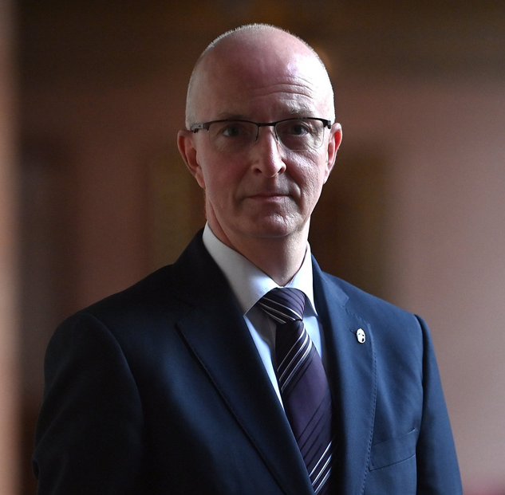
The context of execution
New Kúria President
2020 ~ election of a new Kúria President
- through ad hominem legislative acts of constitutional rank
- without former experience as judge
- against objection of the National Judicial Council
UN Special Rapporteur
„an attack against the independence of the judiciary”
„in violation of the principle of separation of powers”
EC Rule of Law Report
„not in line with European standards”
~ POLITICISATION OF THE POSITION
Notes:
Elevated the chilling effect on the freedom of expression of judges.

Slide 9

Chilling effect
In the Baka case
prevents judges from speaking out publicly against measures undermining the independence of the judiciary
The concept in general
national measures (smear campaigns, political attacks, legal measures, abusive lawsuits)
adopted and/or applied with the aim to dissuade or deter natural persons from fulfilling their professional duties
aiming at creating a self-censorship

Slide 10
General measures expected
CM decisions (since 2017)
  - fully guarantee and safeguard judges’ freedom of expression
  - take measures to lift and countervail the chilling effect
  - evaluate the domestic legislation regarding guarantees against undue interferences
None of the expected measures were taken
- the situation has not been addressed but rather aggravated

Slide 11

Faces of resistance in Poland (2020)

Slide 12
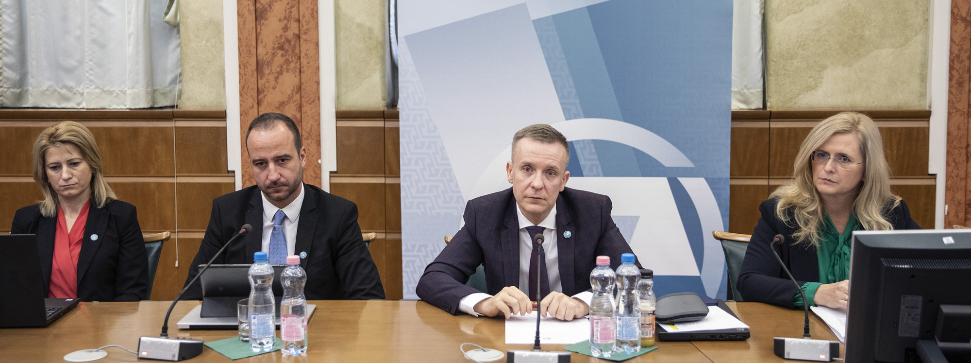
Faces of resistance in Hungary (2022)

Slide 13
Smear campaigns
several waves, same pattern
target: judges as members of the National Judicial Council
method: discrediting members of the NJC as judges
aim: discouraging judges from speaking out
Black campaigns in the Hungarian propaganda media (film 2023)
smear attacks continue even during the NJC elections

Slide 14
Elevation of the chilling effect
from chilling to freezing
      0 °C removal of judge Baka
- 39 °C forced retirement of judges
- 112 °C smear campaigns
- 174 °C undue interferences
- 219 °C attacks on individual judges
- 273,15 °C election of a new Kúria President on political basis
Notes:
- 39 higany - 112 alkohol – 219 oxigén – 273,15 abszolút nulla fok
the situation has not been addressed but rather aggravated

Slide 15
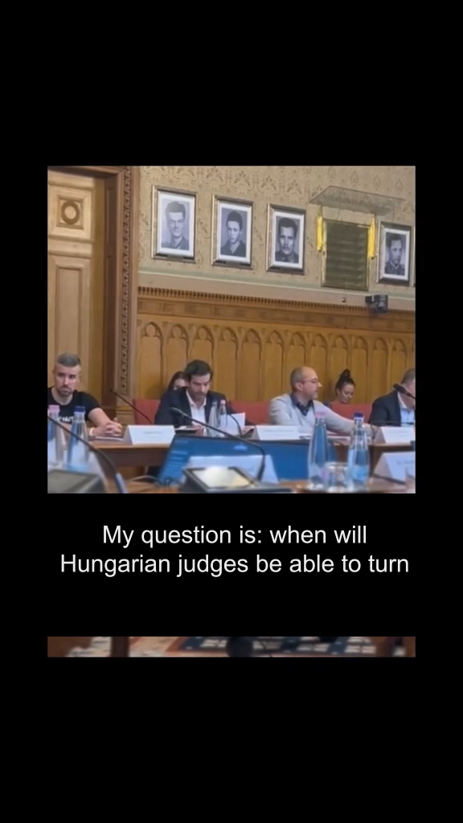
Silencing judges
The active role of the new
Kúria President
  - joined smear campaigns against members of the NJC claiming that „decisions, communications and public appearances of the NJC are political activities”
  - labelled the NJC as a „group of friends”
  - upheld the legal force of the precedent of the Kúria according to which a prelminiary question to the CJEU can be unlawful even after it was found incompatible with EU law
  - quiestioned the right of judges to criticie legislation
  - challenged the new Code of Ethics before the Constitutional Court

Slide 16


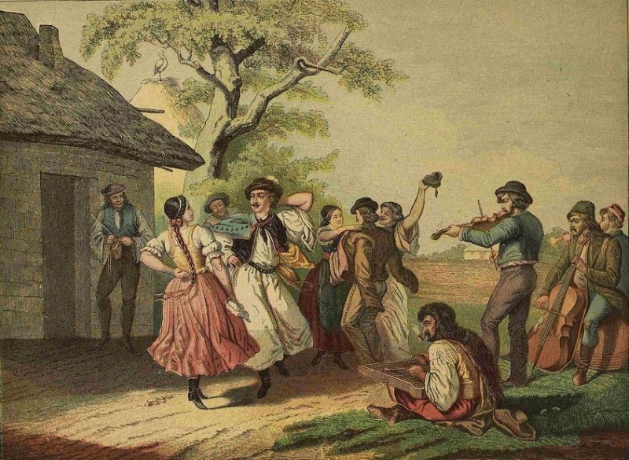
The Code of Ethics
The Csárdás ~ one step forward, two steps backwards
the NJC adopted a new Code of Ethics to implement the Baka judgment
the new Code significantly extends the freedom of expression of judges especially with respect to criticising legislation
the Kúria President challenged the new Code before the Constitutional Court
requesting its annulment and questioning the legal authority of the NJC to adopt the Code
STILL PENDING

Slide 17
Recommendations
  continue examining the case under enhanced procedure
  take into account the changed context of the execution
  require legislative changes
      - to exclude political pressure through the Kúria President
      - to remove the possibility of prolongation of the mandate of Kúria President by political minority
      - to guarantee freedom of expression of judges in accordance with ECtHR judgments
  require Hungarian authorities to refrain from
  - public critique of judicial decisions
  - legislative steps overruling judicial decisions
  - smear camapaigns against judges
  5. evaluate the domestic legislation regarding guarantees against undue interferences

