Slide 1
Presentation On the Supervision of the Execution of the Judgement
In the Case of Selahattin Demirtaş v. Türkiye (no. 2) [GC]
(App. No: 14305/17)
Legal Representative of the applicant Mr Selahattin Demirtaş
Att. Ramazan Demir
27 October 2023, Strasbourg

Slide 2
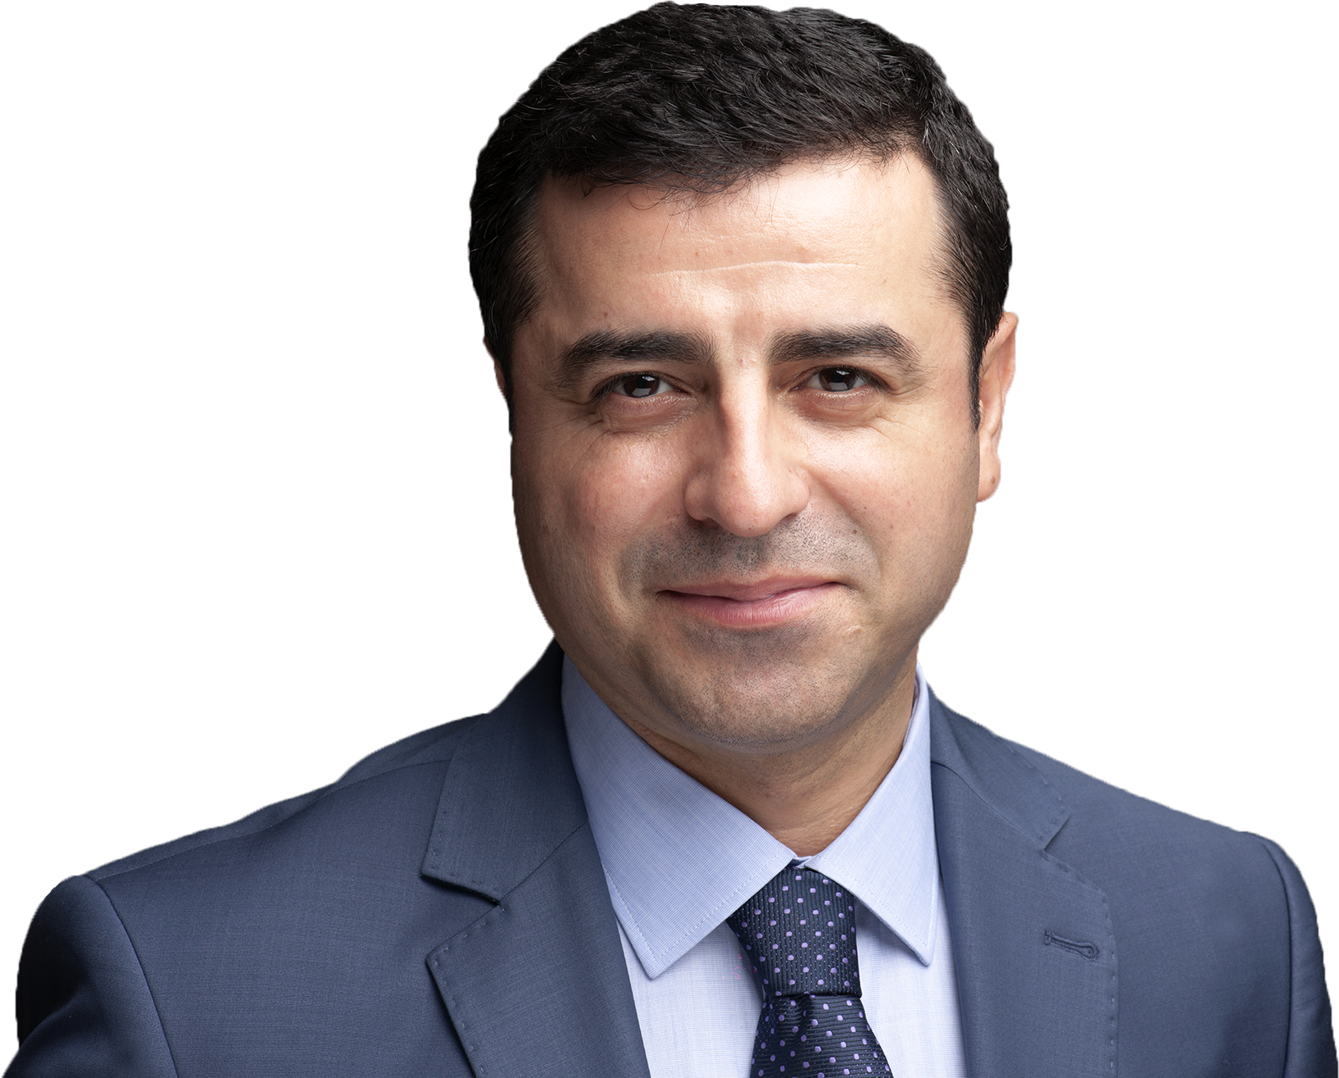
Mr Selahattin Demirtaş, who was at the time one of the co-chairs of and a member of parliament for the Peoples’ Democratic Party (HDP) was placed in pre-trial detention since 2016 on account of allegations that his speeches and statements incited acts of violence between 6-8 October 2014.
Not released after judgment, case referred to GC. Placed in pre-trial detention again under new investigation related to events between 6-8 October 2014.
GC judgment December 2020:
  Second pre-trial detention decision was a continuation of the first pre-trial detention decision.
  Detained with political motives under Article 18
  Must be released immediately

Slide 3
The Government’s arguments
the applicant’s detention subject to the Court’s judgment has ended;
the current detention falls outside the scope of the present application;
new charges, evidence and allegations (i.e. witness and anonymous witness statements) were in substance different from those examined by the Court in its judgment;
the necessary individual measures have been taken.

Slide 4
The Government alleges that Mr Demirtaş’s continued detention, on the basis of a new charge, amounted to a new fact, raising a new problem, one that had not been examined by the Court. However:
The charges against the applicant have not changed in substance
Witness/anonymous witness statements have not contained any substantially new facts capable of justifying a new suspicion and the substance of these statements had been based on facts that were similar or even identical to those that the Court had already examined in the Demirtaş v. Türkiye (no. 2) [GC] judgment.
The witness statements:
  are contradictory, inconsistent and false,
  their content and accusations essentially concern the events of 6-8 October and that Demirtaş is a member of/executive for a terrorist organization
  are added to the case file approximately 2.5, 3.5, 17, 29, 32 and 33 months after the pre-trial detention decision and are used as tools to keep the applicant in prison.

Slide 5
Ongoing judicial harassment against the applicant:
4 years and 8 months prison sentence in second set of proceedings used as a tool to prevent the applicant’s release and to prevent his participation in any election
47 cases filed against the applicant, 10 cases remain pending under different courts
New indictment prepared for the dissolution of the HDP and the political ban on politicians including the applicant
The Constitutional Court has not delivered any judgment for the application related to the second pre-trial detention of the applicant since 7 November 2019

Slide 6
We kindly urge the Committee of Ministers to:
request the Government of Türkiye to release Mr Demirtaş immediately;
request the Government of Türkiye to take measures compatible with the Grand Chamber judgment and to drop all the charges brought against the applicant together with the removal of all other negative consequences of the constitutional amendment;
urge the Constitutional Court of Türkiye to conclude, without delay and in line with the Grand Chamber judgment, the individual applications which are listed between paragraphs 23 and 25 of our Rule 9.1 submission dated 17 May 2021;

Slide 7
We invite the Committee of Ministers to:
underline that the continuing detention of Mr. Demirtaş constitutes a violation of Article 46 of the Convention on the binding nature of final judgments of the ECtHR which may trigger Article 46/4 of the Convention;
examine the applicant’s situation at each regular and human rights meeting of the Committee until such time that he is released;
invite the Secretary General of the Council of Europe, member states and international human rights organisations to raise the case and the ongoing judicial harassment faced by the applicant in diplomatic talks between members of the Council of Europe and Türkiye;
write a letter to the Minister of Foreign Affairs of Türkiye to urge the Government to fully execute the Grand Chamber judgment.

